Slide 1
SOLARROK – Regions of Knowledge
A Region-based Approach to Strengthen
Photovoltaics R&D & Industry in Europe

Slide 2
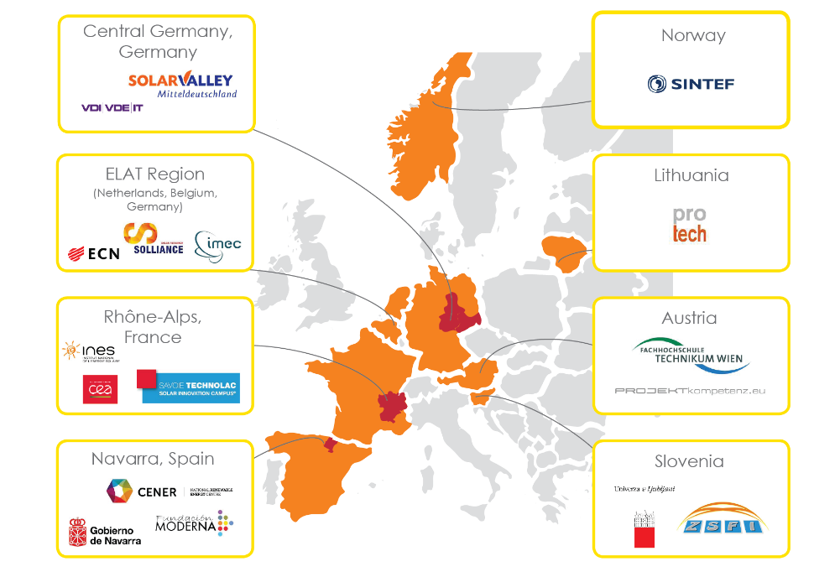
SOLARROK Regions / Clusters
7 Photovoltaics clusters in 9 European countries,
represented by 15 partners

Slide 3
Objectives
Support a better coherence of European R&D in Photovoltaics
Set a basis for joint R&D activities
Exchange cluster management best practices
Initiate a strategy for joint market development
Focus European RTD activities on innovation hot spots

Slide 4
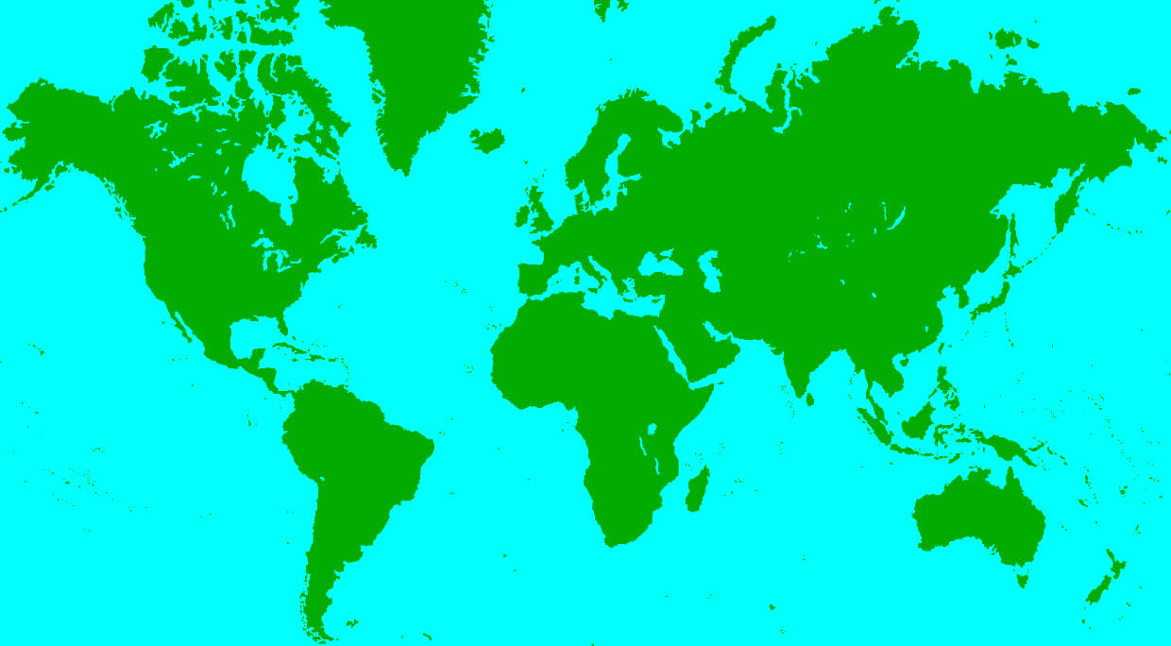

SOLARROK Workplan
2013 2014 2015
  in-depth analysis of
  regional innovation strategies and actors
  benchmarking
  with international
  PV clusters
  development
  of a consortium
  Joint Action Plan
  initiation of
  joint PV-related RTD projects
  consultation process with regional and European authorities
  European Joint Action Plan based on
  regional strategies

Slide 5
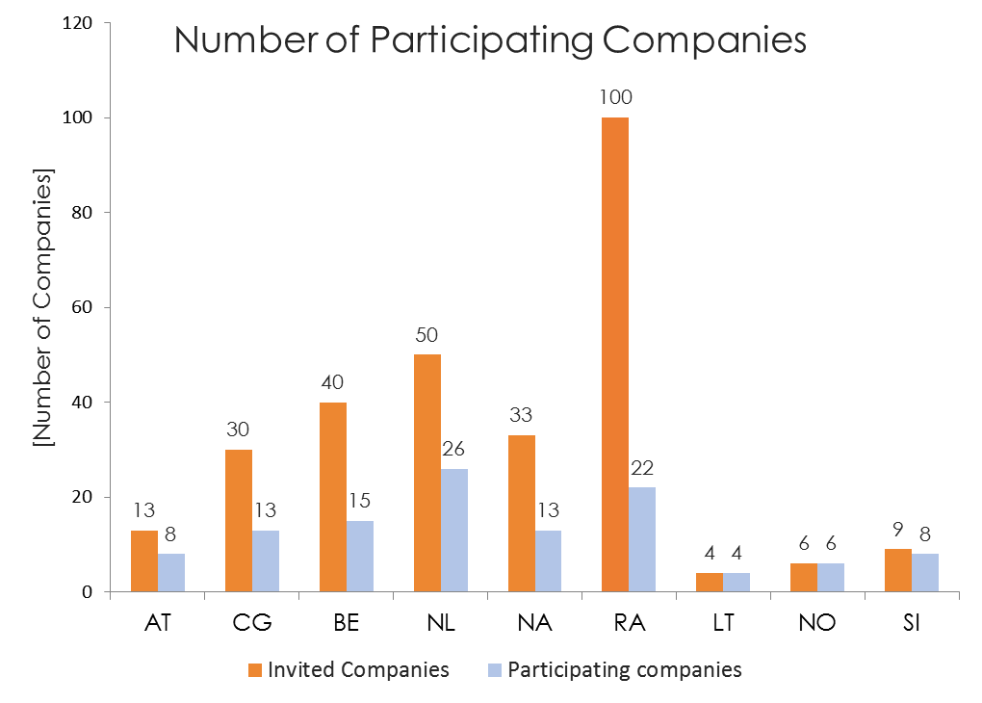
Survey of SOLARROK R&D and Business Landscapes (full report from www.solarrok.eu)
Participants in this survey:
74 RTD institutions
115 companies

Slide 6
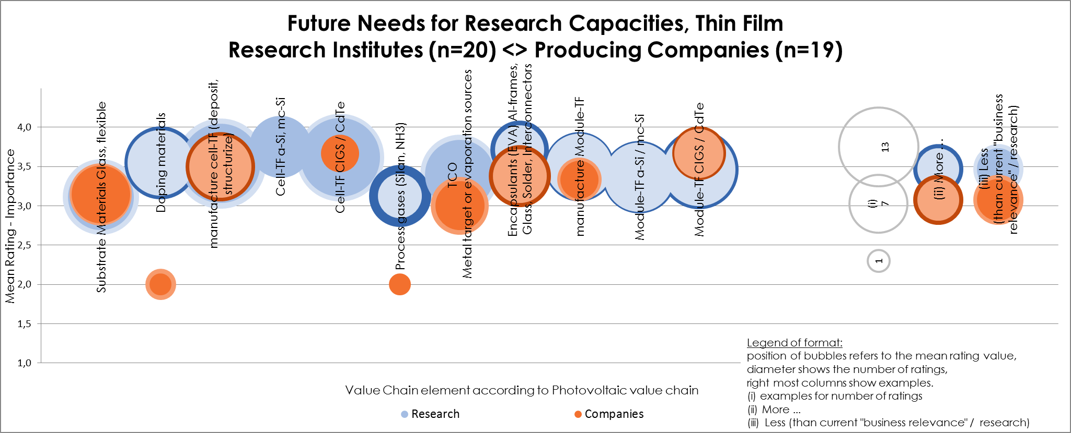
Example Solarrok survey: Importance of Thin Film PV in future
Similar importance of research on value chain elements of business and research institutes

Slide 7
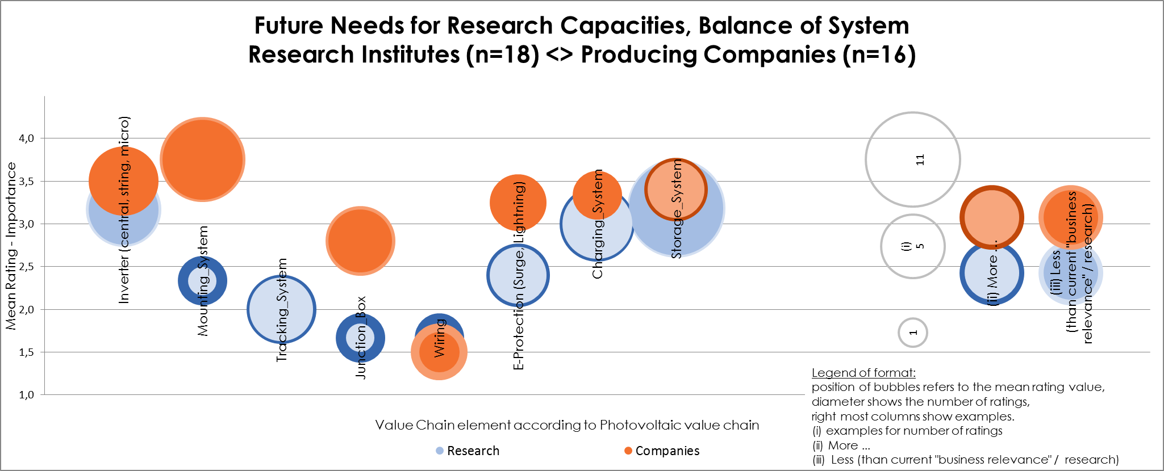
Example Solarrok survey: Importance of BOS in future
Increasing importance of R&D in BOS components
Lack of emphasis from researchers’ perspective

Slide 8

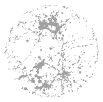

Example Solarrok: Joint Actions (from regional best practises)
New tools and approaches | Sharing & Using Synergies | Awareness for new application fields
OVERCOMING BARRIERS (National action plan Solar Electricity, The Netherlands) | PV STANDARDS IN EUROPEAN CONTEXT | BEST PRACTICES OF PV GRID INTEGRATION
E-LEARNING FOR SUSTAINABLE BUILDING DESIGN | R&D INFRASTRUCTURES (Solliance as an example of smart specialisation) | TECHNICAL SOLUTIONS IN THE LOW VOLTAGE LEVEL
SOLARROK VIRTUAL MARKETPLACE | FORMING PV BRIDGEHEADS IN EMERGING COUNTRIES | BIPV APPLICATIONS (Rhône-Alps)
CIRCULAR ECONOMY FOR THE SI-PV INDUSTRY
TANDEM SOLAR CELL FOR FLAT PLATE PV

Slide 9






Nationaal Actieplan Zonnestroom
9

Slide 10
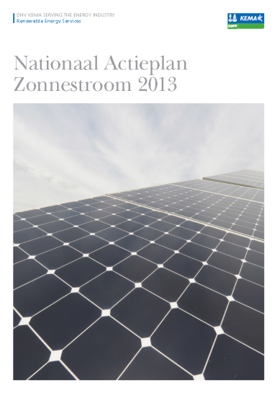
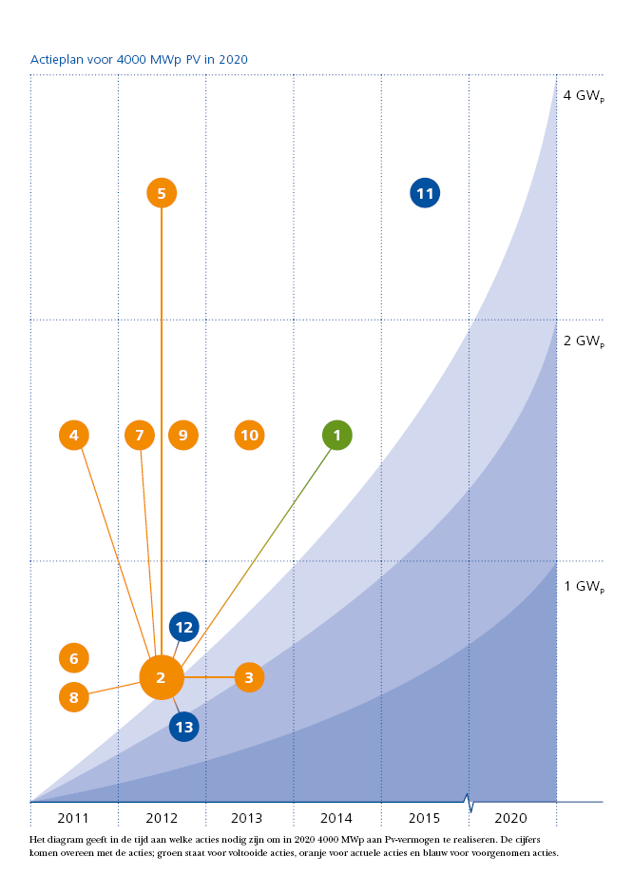
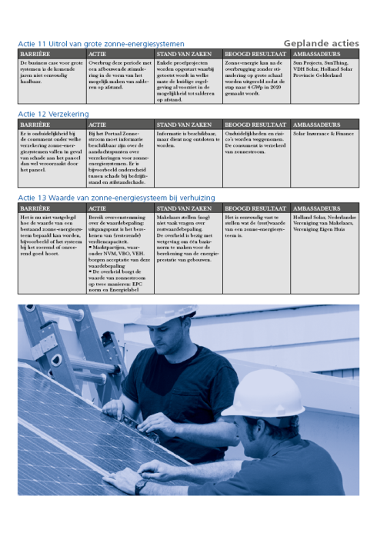
Het Nationaal Actieplan Zonnestroom is…
… een actieplan dat barrières voor grootschalige uitrol van zonnestroom adresseert en wegneemt.
… een marktinitiatief met ambassadeurs
… een breed gedragen plan:
  Producenten
  Leveranciers
  Kennisinstellingen & adviseurs
  Netwerkbeheerders & energieleveranciers
  Banken & Verzekeraars
  Belangenorganisaties
… doelstelling voor 4 GW_{p} in 2020
… zie verder dit symposium, Bas Vet (DNV-GL)

Slide 11
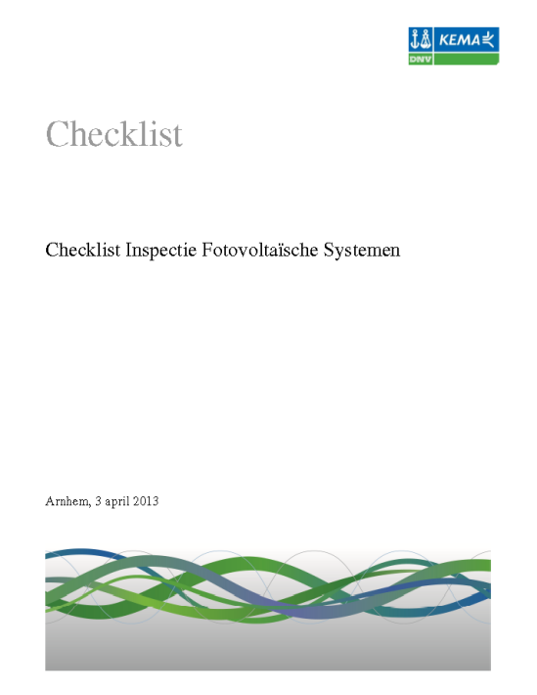
Voorbeeld:actie 4 Systeemkwaliteit
Barrière: Door prijsdruk kan de kwaliteit onder druk komen te staan. Er is behoefte aan kwaliteitsborging voor het hele systeem
Actie: Er wordt een checklist opgesteld voor een beproevingstest. Deze checklist wordt ingevuld na systeeminstallatie.

Slide 12
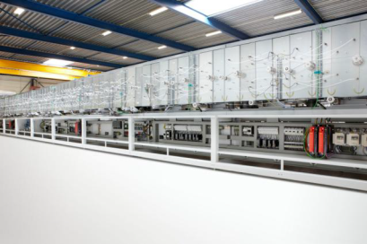
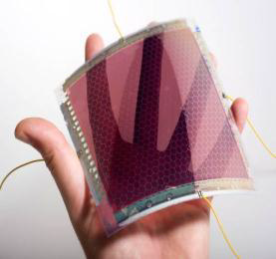

Solliance is about joining forces
Industry
Research Organizations
Government

Slide 13







Solliance programs
Open innovation
Shared Research
OPV
Ronn Andriessen
TF-Si
Paul Pex
CIGS / CZTS
Ando Kuypers
High Efficiency
To be started in 2013
III-V
Multi-junction
HE f-Si
X
TNO
X
X
X
ECN
X
Holst
X
X
X
X
IMEC
X
Julich
X
X
X
X

Slide 14
Solliance: reduces R&D risks & costs
Total Company Revenue
Innovation becoming more complex:
we can’t stop innovating…
…but we can’t bear all the costs and risks anymore
Leverage:
Innovating by combining ideas
Sharing of facilities and competencies
Reducing time to market
Sharing of R&D costs and risks
Opportunities for additional public funding
R&D Budget
Exclusive R&D
Shared R&D
Solliance leverage
Typical >10x leverage

Slide 15
Solliance, an example of EU strategy on smart specialisation
Bottom-up formation, triple helix involved
Granularity: support growth of new activities but not whole sector neither single firms
Entrepreneurial discovery (HTC smartest km2, > 125 companies)
Maximize chances for spill-overs (e.g., within HTC domains of energy and smart environments)
Structural evolution of regional economy (many spill-overs thin-film technology)

Slide 16
On the other hand………….smart specialisation??
Funds are not allowed to cross borders (national or province)
Solliance is not considered as “one party” in EU-funded R&D projects, so difficult to enter with project proposals (considered as too many parties from one country)

Slide 17
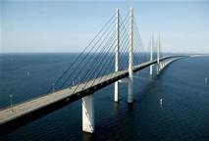
Joint Actions: selected examples
Forming PV bridgeheads in emerging PV countries
Invite delegates from emerging PV countries for
a 2 weeks tour-de-PV-Europe June 2015
Establish lasting personal relations with local PV bridgeheads through visits, joint projects, exchanges of staff and information and thereby extending the network for European PV stakeholders
Focus countries 2014-2015: Tunisia, Egypt & Turkey
Delegates with representatives from national solar energy associations, R&D institutes & governmental bodies

Slide 18
Joint Actions (from regional best practises)
New tools and approaches | Sharing & Using Synergies | Awareness for new application fields
National action plan Solar Electricity, The Netherlands | PV STANDARDS IN EUROPEAN CONTEXT | BEST PRACTICES OF PV GRID INTEGRATION
E-LEARNING FOR SUSTAINABLE BUILDING DESIGN | R&D INFRASTRUCTURES (Example smart specialisation: Solliance) | TECHNICAL SOLUTIONS IN THE LOW VOLTAGE LEVEL
SOLARROK VIRTUAL MARKETPLACE | FORMING PV BRIDGEHEADS IN EMERGING COUNTRIES | BIPV APPLICATIONS (Rhône-Alps)
CIRCULAR ECONOMY FOR THE SI-PV INDUSTRY
TANDEM SOLAR CELL FOR FLAT PLATE PV

Slide 19
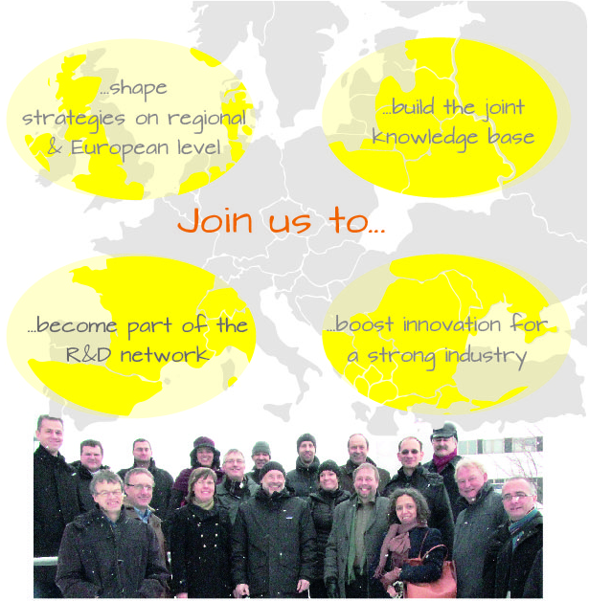



www.solarrok.eu
Contact:
Coordinator
Dr. Sabine Schmidt
Solar Valley GmbH
s.schmidt@solarvalley.de
Dr. Marc Meuris
imec
marc.meuris@imec.be
Dr. Marie-Charlotte Hoffmann
PROJEKTkompetenz.eu GmbH
m-ch.hoffmann@projektkompetenz.eu

