Slide 1
EFFIC
(Equipment for Free Form Interconnection of CIGS)
Jan Wemmenhove, PM Smit Ovens
Sunday 2014 event
Nov. 19th, 2014

Slide 2


Content
Brief company introduction
Brief introduction into CIGS panel production
Back-end interconnection process
Development status

Slide 3
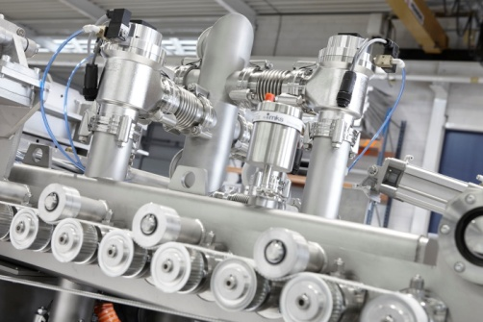
Company introduction
General
Founded in 1936 in Nijmegen, the Netherlands. Today, our headquarters are in Eindhoven
Background in display and glass
  Including large area glass treatment
  High temperature glass treatment (T>T_{g})
  Residual stress / deformation
  Cost effective mass production
Continuous innovation with focus on
  Yield improvement
  Cost reduction
Notes:
2

Slide 4
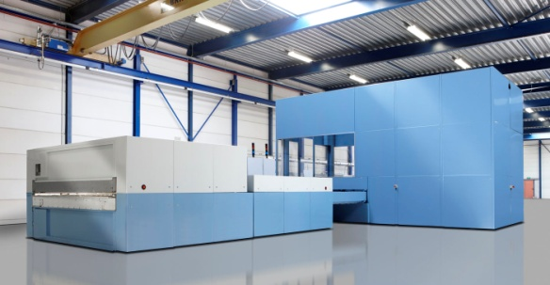
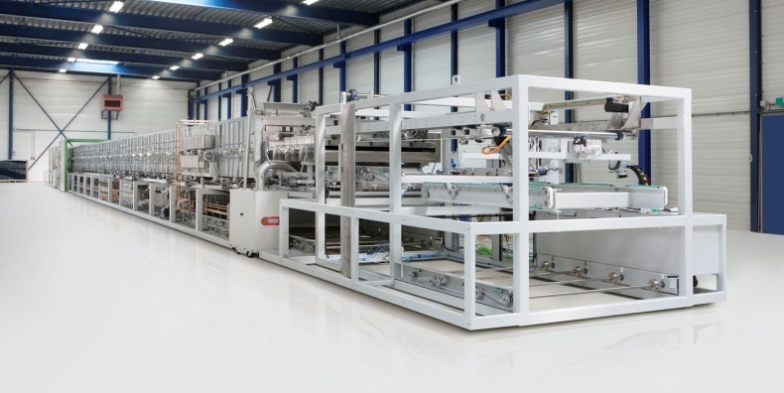
Company introduction
Solar market position
Leading position in thermal equipment for TF solar panel production
  Installed base of 110 systems in total solar market
  Supplied for > 4,3 GWp annual production capacity
Development partner & reliable supplier to all major TFPV manufacturers

Slide 5
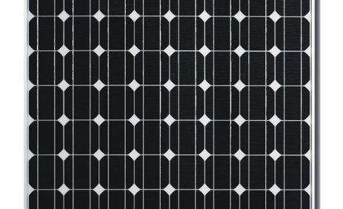
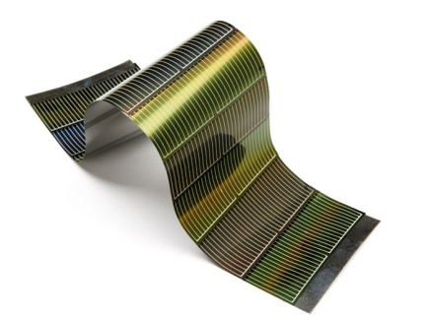
Crystalline and thin film solar panel technologies
Crystalline
Thin-film
Fixed panel
Composed of multiple solar-cells, made from silicon wafers (similar to microchips)
Used in most PV-systems
Based on Silicon (c-Si) or Gallium Arsenide (GaAs)
Fixed (glass) or flexible thin sheet
Several thin layers which act as one big solar-cell
Used in special applications and large plants
Based on Silicon (a-Si), Cadmium Telluride (CdTe), Copper indium gallium
selenide (CIGS) or Organic materials

Slide 6
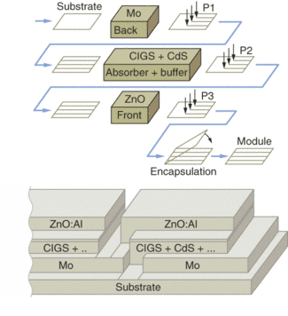

State of the art manufacturing of TFPV panels
Each manufacturer has a single standard, one size only panel.
Standardized manufacturing lines are optimized for lowest cost of this specific module ($/Wp).
For optimal panel performance cells (± 700 mV) are formed & electrically interconnected in the manufacturing line using lasers (in case of CIGS, a mechanical scribe of P2 and P3 is very common) .
This one size/fits all approach is
  OK for power plant / free field applications
  Not ideal for building integrated (BIPV) applications

Slide 7
Disadvantages current production process.
Module output loss: IC zone does not contribute to module output.
Production yield loss: material removal is source of contamination for the subsequent TF deposition processes.
Limited module customization.

Slide 8
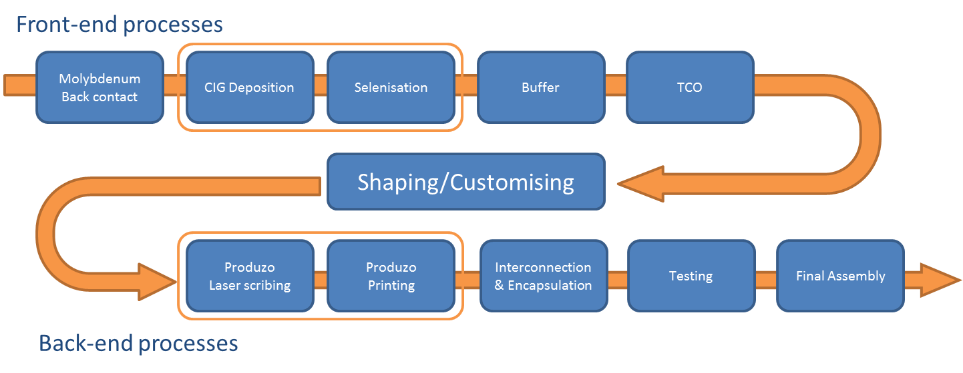
EFFIC solution
Alternative approach structuring/interconnection
Instead of doing the interconnections as integral steps in the line it is also possible to take a font end / back end approach
  Front end would be the monolithic deposition of all funtional layers
  Back end would be shaping, cell structuring, interconnection & lamination

Slide 9
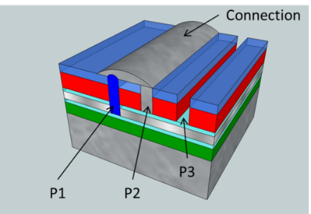
Advantages back-end interconnection process
Higher conversion efficiency of TF PV modules due to lower output losses in cell interconnection.
Lower CoO for module manufacturing , because back-end interconnection reduces defect formation and increases the production yield.
More flexibility of the interconnection layout at the end of the production process of PV modules.

Slide 10

Different interconnection technology required
Besides material removal by lasers it is also required to add materials: isolators & conductors
To maintain flexibility
and large area precision
Inktjet printing is the
preferred deposition
method
Process development
ongoing.

Slide 11
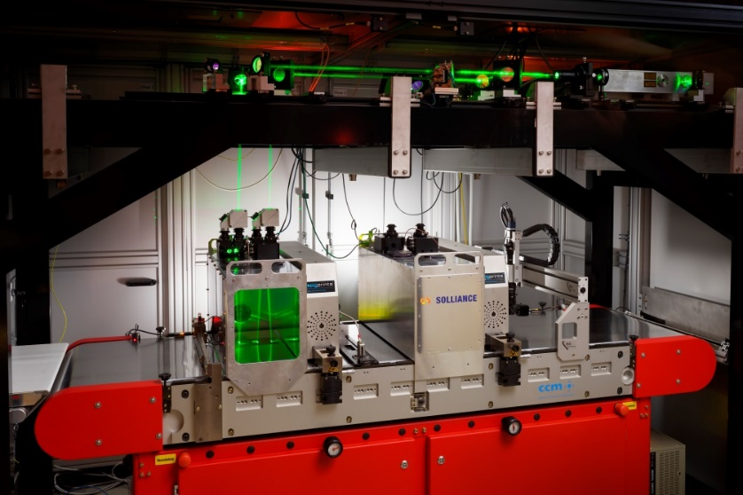
Produzo tool

Slide 12
Main advantage of a front/back-end approach
Flexibility in size & shape is possible
  Relatively large front end substrates (e.g. 1200 x 1200 mm)
  Store these coated mother plates in N2 conditions
  Mechanical sizing of these plates to a specific demand
  Fast response to a market request, e.g. delivery < 7 days on site
  Full shape freedom including triangles, rounded, circles, etc
  Nesting programs to optimize material usage & cost
  Cell structuring & interconnection scheme optimized by software for each different module
Except for flexible cell structuring & interconnection no new technologies required to implement this approach

Slide 13
Customer analysis
Potential customers/segments
Potential customers:
TF PV manufacturers (CIGS as well as Si, CdTe and on the longer term OPV).
PV development labs.
Suppliers of functionalized steel and glass, building and construction materials (through their suppliers).
Potential future development: foundries taking producing customer/project specific modules based on standard cell materials.
Segments:
BIPV (Building Integrated PV): PV systems incorporated in building elements.
BAPV (Building Added PV): PV systems added to existing buildings.

Slide 14
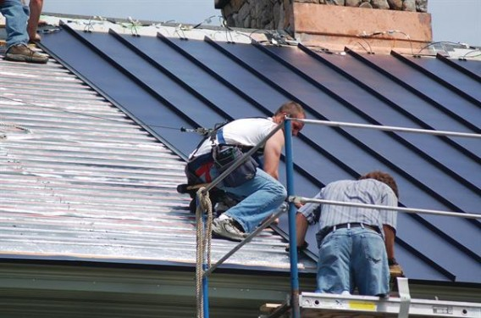
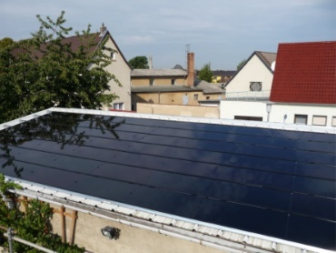

Supporting local PV panel manufacturing
The market approach
is different and supports
a local for local approach
Much more comparable to
e.g. double glazing
Good possibility to
allow for EU
manufacturing on
highly automated
production lines

Slide 15
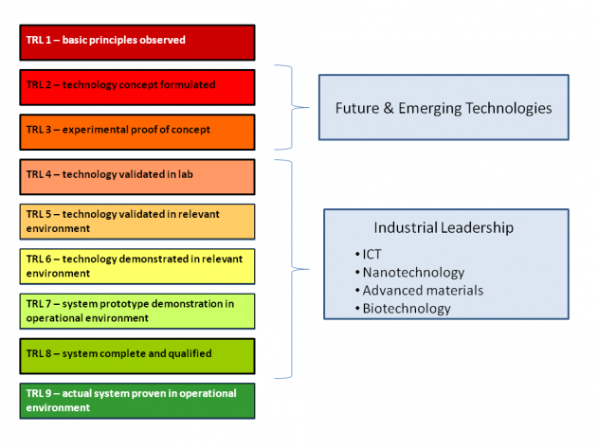
State of development of the product at the end of the project
Start of project:
  TRL3: concept of back-end interconnecting lab-scale TF Si and CIGS cells has been proven.
  Lab scale validation is still needed (TRL4).
End of project:
  TRL6: Product demonstrated with extensive testing on relevant PV modules of industrial CIGGS manufacturer Nexcis (60x30 cm).
At project closure, the design will have been upscaled to cover full market potential (60x120 cm).

Slide 16
Thank You
SMIT Ovens BV
Ekkersrijt 4302
5692 DH SON
The Netherlands
Visit us at www.smitovens.com
Notes:
15

