Slide 1

State of art high efficiency Si Solar cell production
Hans Scholing
Sales Director
November 19th, 2014

Slide 2
AGENDA
Introduction
  Tempress Systems
  Solar cell production line
Market for Solar modules
  Cost, efficiency, technology
Innovation at Tempress Systems
  Furnace improvement
  New furnaces
  Cell technology

Slide 3


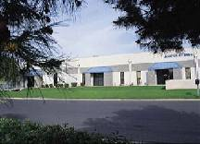
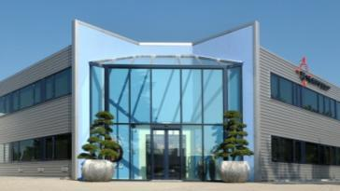
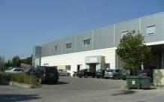


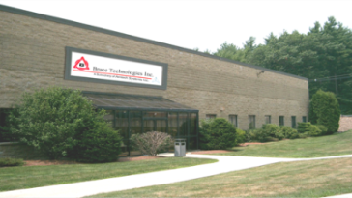
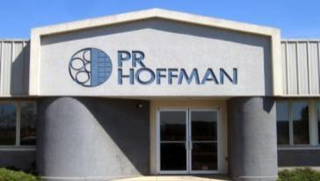
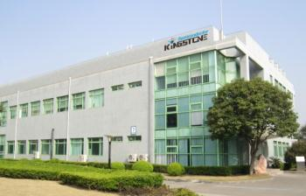
AMTECH GROUP
Tempe, Arizona, USA
Vaassen, Netherlands
Clapiers, France
Massachusetts, USA
Carlise, Pennsylvania, USA
Shanghai, China

Slide 4
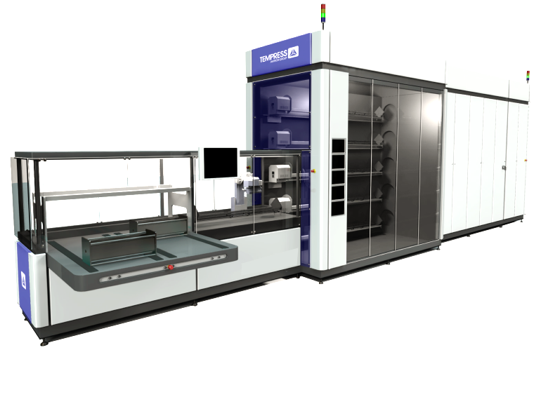
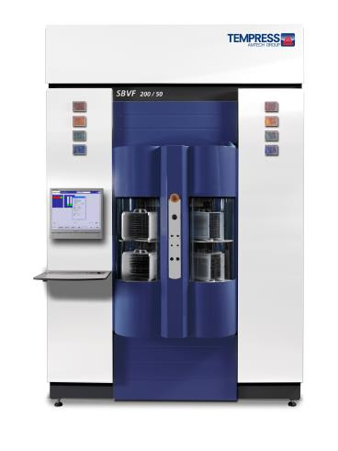
AMTECH Group markets
SEMI / MEMS
SOLAR

Slide 5
Tempress in SOLAR
500 systems at customers
Production capacity >21 GW
Diffusion share >35%
GW
Sources:
Internal data center
Market share by Solar Buzz Research

Slide 6
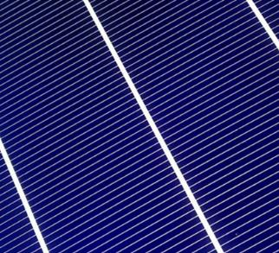
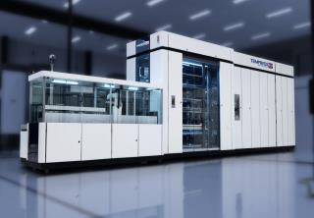
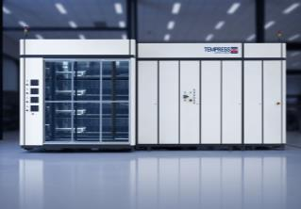
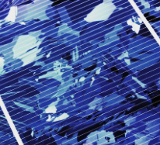
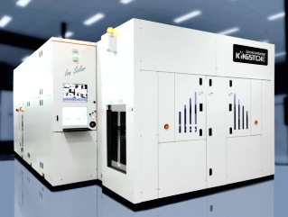
Tempress products
Mono
p-type / n-type
Tempress Diffusion
POCl3
HD POCL3
BBr3
Annealing
Oxidation
R&D system
Tempress LPCVD
Multi
PECVD SiN_{x}, SiO₂
LPCVD Poly
Kingstone IonSolar
p-type / n-type
IBC

Slide 7
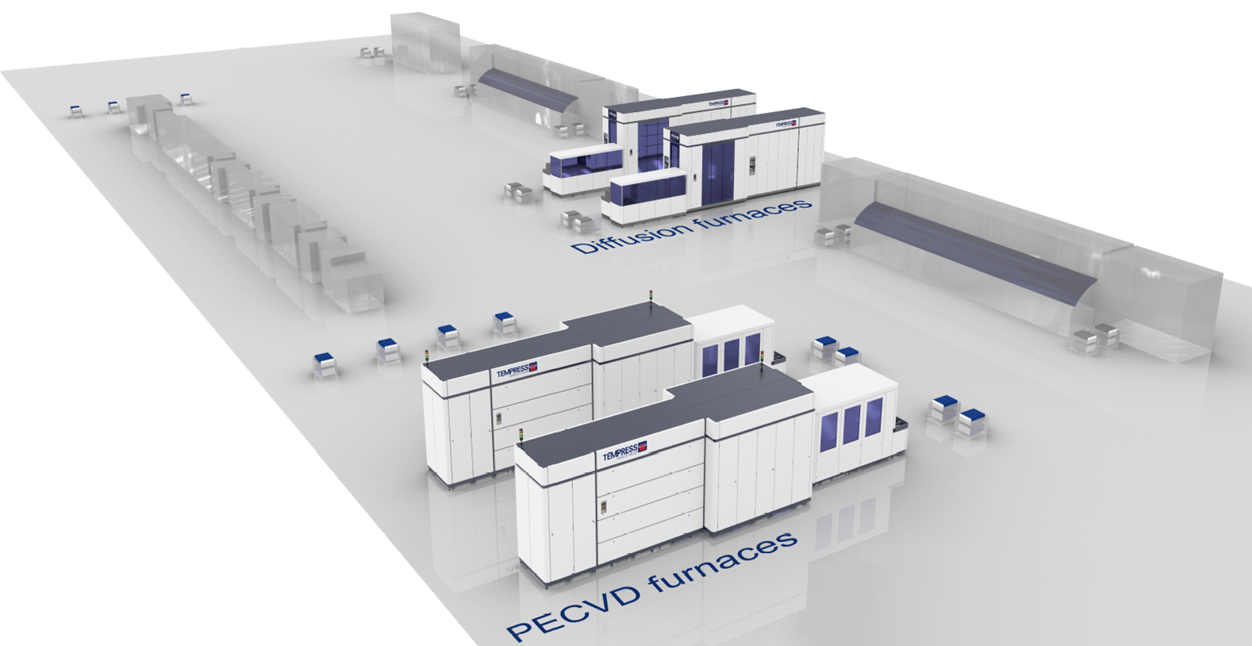
PV cell line (multi); 80% production
100MW production 24/7
2800 cells/hour
±22M cells 4.5Wp/cell
385k modules/year; 60 soccer fields
Average modern factory has 10+ lines

Slide 8
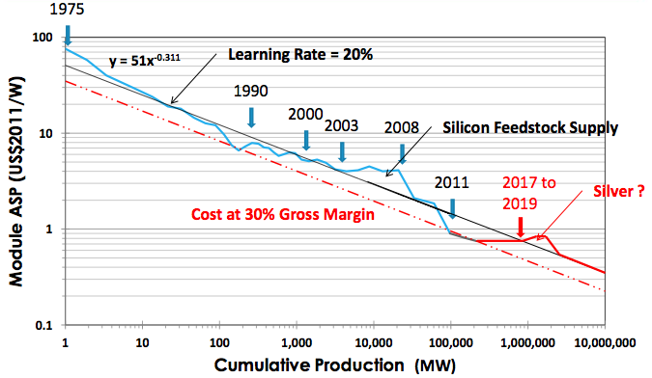
Historical price of modules
From: Verlinden, Trina Solar, 2014
Cost:
  Now 0.6$ct/Wp
  Minus 20% each doubling
Price now only slightly above cost due to over-capacity
Still big influence of regulation (import tax, Feed in Tariffs)
Current cost structure
Lowest of all alternative energy recources
World wide: PV electricity cost: 5 – 12 Eurct/kWh
NL: 6 – 10 year pay-back time
In 2020 the expected PV electricity cost is 2.5 Eurct/kWh (US, AZ)
Notes:
Laagste van alle alternatieve energie vormen (ook beter dan wind)
3 – 10 jaar terug verdientijd afhankelijk van elektriciteitskosten en systeem prijs
elektriciteitsprijs Eur2.5ct/kWh (US, Az); vergelijkbaar met kolen-stroom (zonder CO2 belasting)

Slide 9
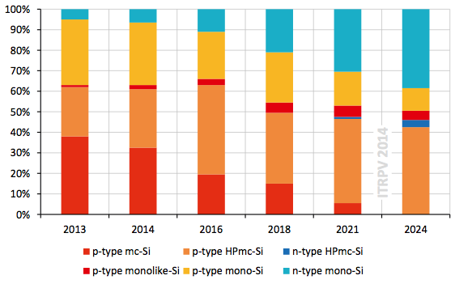
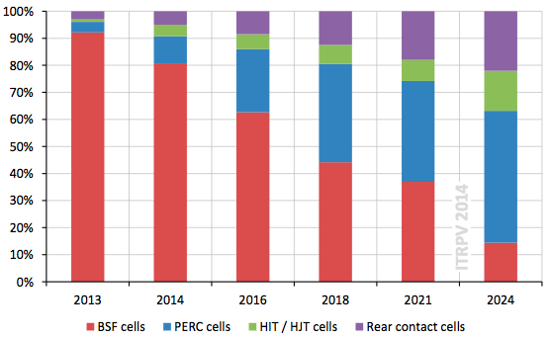
Wafer / Cell type
From: ITRPV roadmap, 2014
N-mono
P-mono
WAFERS: Higher efficiency
➔ n-type & High Performance-multi
CELLS: Higher efficiency
➔ Rear side contact and PERC
HP-multi
Multi
2014 2024
Rear contact
PERC
Rear BSF
2014 2024
Notes:
Voorspellingen van markt analysten geven aan dat er over 10 jaar een grote verschuiving plaatsvindt van de huidige technologien naar hogere efficientie technologien voor zowel wafers als cellen. De reden is dat de kosten van wafers en cellen moeilijk nog verder omlaag te brengen zijn, en de winst nu in betere technologie zit.

Slide 10
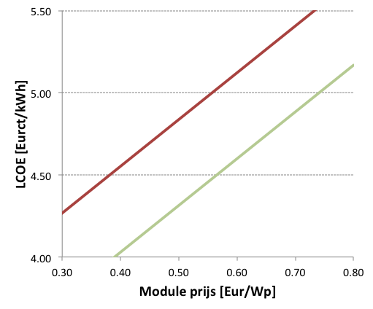
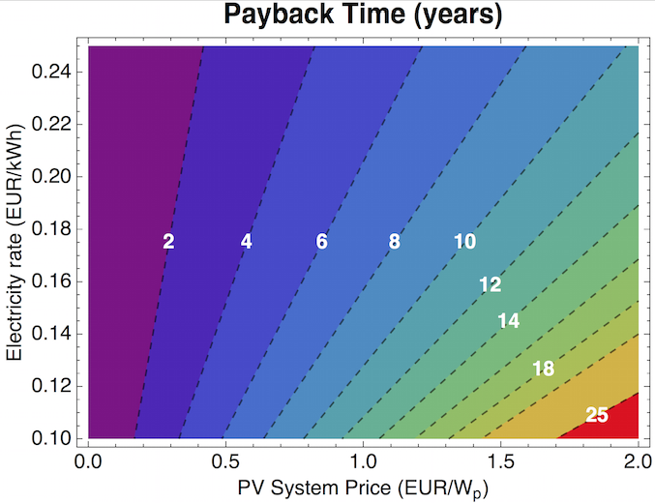
Cost and efficiency
4% higher module efficiency; 10% better LCOE
1 to 2 years shorted pay-back time
High efficiency modules are thus very attractive
250Wp
320Wp
From: Louwen, Universiteit Utrecht, 2014

Slide 11
AGENDA
Introduction
  Tempress Systems
  Solar cell production line
Market for Solar modules
  Cost, efficiency, technology
Innovation at Tempress Systems
  Furnace improvement
  New furnaces
  Cell technology

Slide 12
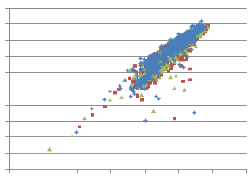
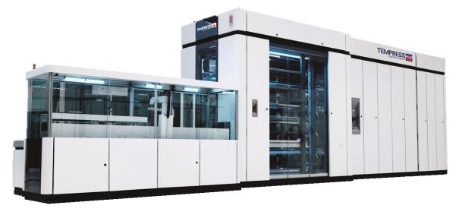
New furnaces; higher throughput
Voc vs efficiency (10000 cells)
■ HD-POCl3 group 1
■ HD-POCl3 group 2
■ Customer Baseline
Cell efficiency →
3200
wfr/hr
From 1600 to 3200 cells per hour
Stable operation
Also for high efficiency cells
Full automation
Installed at 1 customer (250MWp)
Voc →

Slide 13
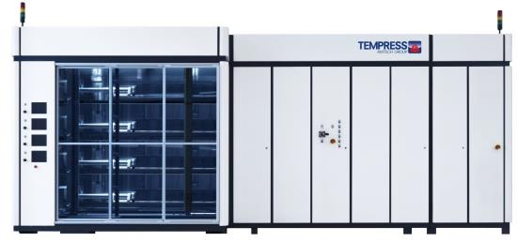

New furnaces; PECVD
1800
wfr/hr
Tempress
(Direct Plasma)
Vendor A
(Direct Plasma)
Vendor B
(Remote Plasma)
Higher though-put; 1800 wafers / hour (1400 competition)
Better efficiency of cells
Higher quality cells (PID free)
Installed at 4 customers (400MWp)

Slide 14
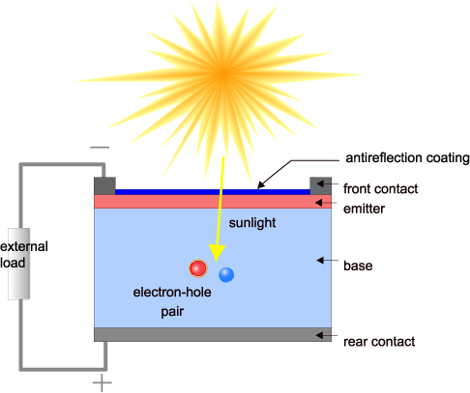
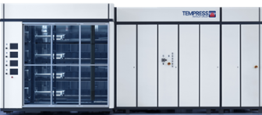
Tempress products for standard p-type
p-type
Notes:
In a standard p-type line, our presence is limited to the Emitter formation on the front side, and the anti reflective coating, also on the front side. So normally it doesn’t make real sense for us to offer this as turn key supplier because our share is about 30% of the total line.

Slide 15
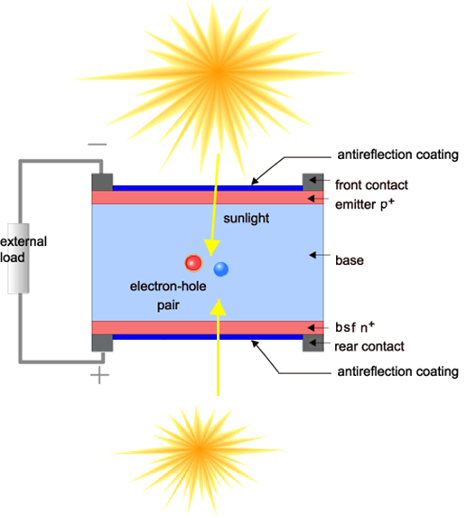
Tempress product for advanced cells
p-type
Albedo light from the back
Notes:
In a more advanced cell structure like n-type or PERC structures, the line needs additional production tools from Tempress, for processing on the backside of the Solar cell. In this advanced lines the amount of Tempress equipment almost doubles, so our involvement is much more important

Slide 16
Generations of technologies
Standard p-type multi/mono (2006 – 2012) – cell efficiency 18%
inspection
Texture
POCl3
Single side etch
PECVD
Print/fire/Flash
PERC multi or mono (2013 – 2018) – cell efficiency 19 – 20%
inspection
Texture
POCl3
Single side etch
ALD AlOx
PECVD
front
PECVD
rear
Laser
Print/fire/Flash
N-type mono (2014 – 2024) – cell efficiency 21 – 23%
inspection
Texture
BBr3
Single side etch
Implant
Anneal ox
PECVD
front
PECVD
rear
Print/fire/Flash

Slide 17



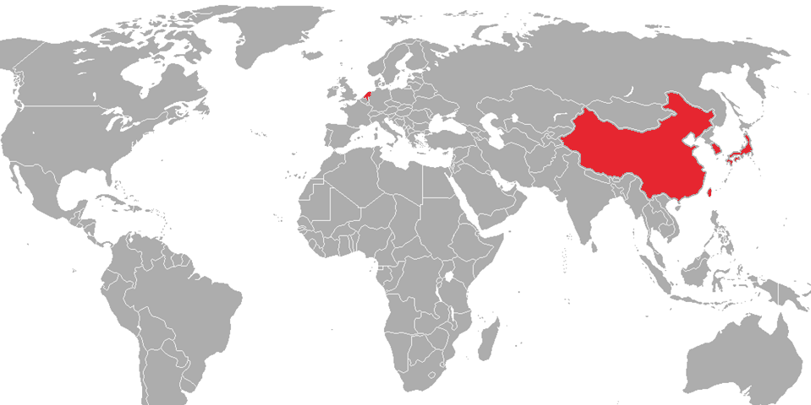



N-type technology to China / USA

Slide 18







Cooperation on new n-type technology
Together with partners in the Netherlands, Tempress develops new n-type cell technology with 21% and higher efficiencies

Slide 19
Conclusions
Big solar factories have reduced the cost of solar panels in a very high pace, resulting in pay-back times of solar systems of 5 to 10 years
Tempress is a large supplier of solar cell equipment and is working on innovative machines to make cheaper and more high efficient solar cells
Higher cell efficiency results in big improvements in pay-back time of PV systems
Together with partners Tempress works on improved solar cell technologies
New equipment of Tempress is being introduced to the market and we expect new solar cell lines to be even more competitive

Slide 20
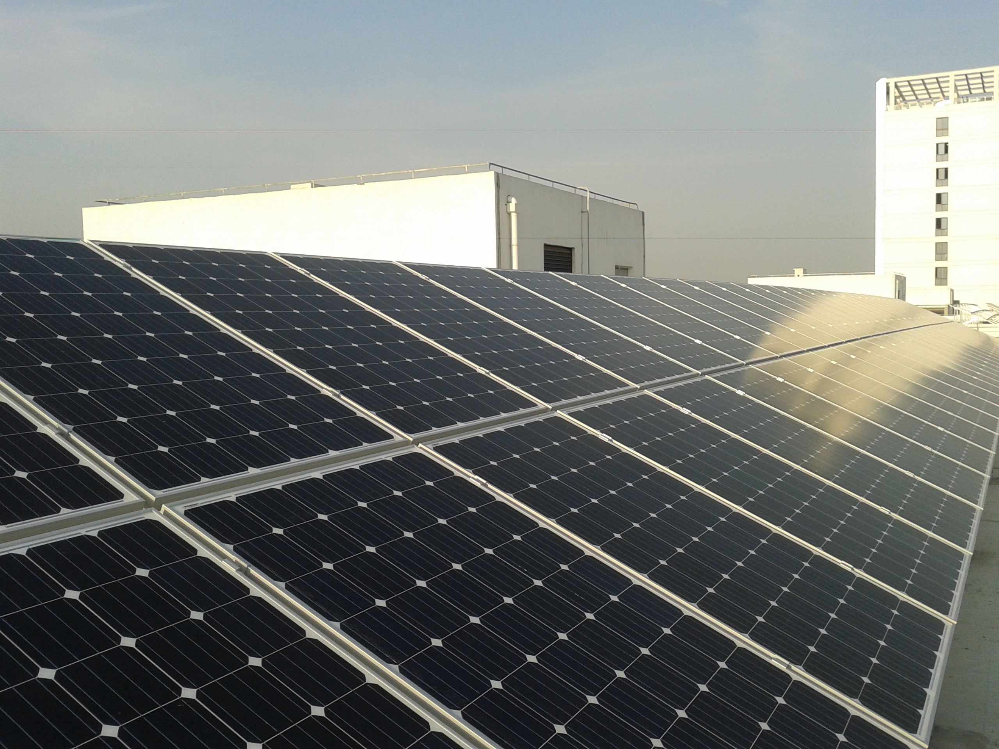
THANK YOU FOR
YOUR ATTENTION.
200kW IIF project w 285Wp panels
ROADMAP TO HIGHER EFFICIENCIES AT LOWER COST

