Slide 1
Award categories:
- Solar Thesis Award
- Young Solar Award
- Industry Development Award
- Project Development Award

Slide 2
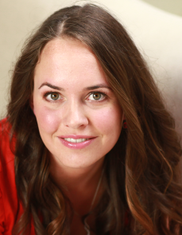
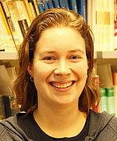
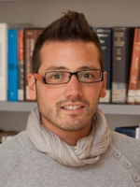
Solar Thesis Award, nominees:
Claire van Lare (FOM Amolf)
Mirjam Theelen (TNO/TU Delft)
Andrea Ingenito (TU Delft)

Slide 3
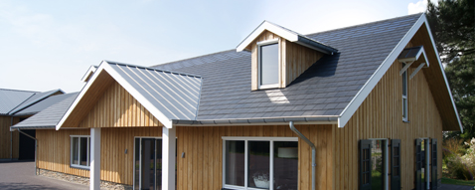
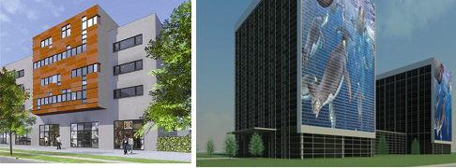
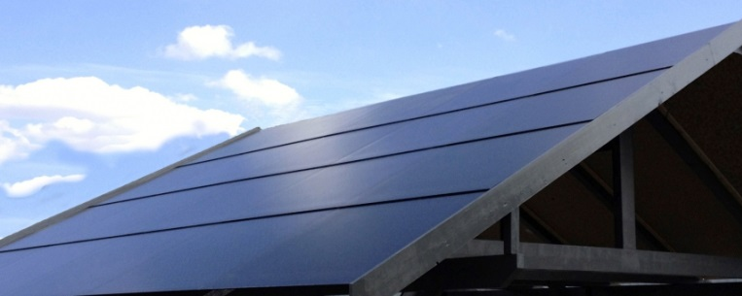
Young Solar Award, nominees:
Synroof
Wallvision
AERspire

Slide 4
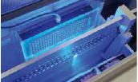
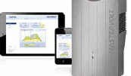
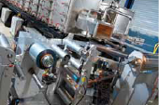
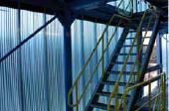
Industry Development Award, nominees:
Meco Equipment Eng. | cell plating line
Mastervolt | Soladin WEB
VDL Flow | Roll-to-roll dunne film
Rodeca Systems SmartSkin Solar

Slide 5
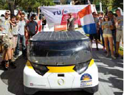
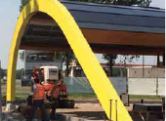
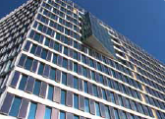
Project Development Award, nominees:
Solar Team Eindhoven | Stella
SolarToday | Solar snellaadnetwerk
Hermans Techniek Energy | The Edge

