Slide 1


PV potentieel in Nederland &
Zonne-energie voorspelling

Slide 2
Inhoud
Introductie
PV potentieel
PV netwerk integratie
  DNV GL National Smart Grid Model
  Bottom-up aanpak
Conclusies

Slide 3
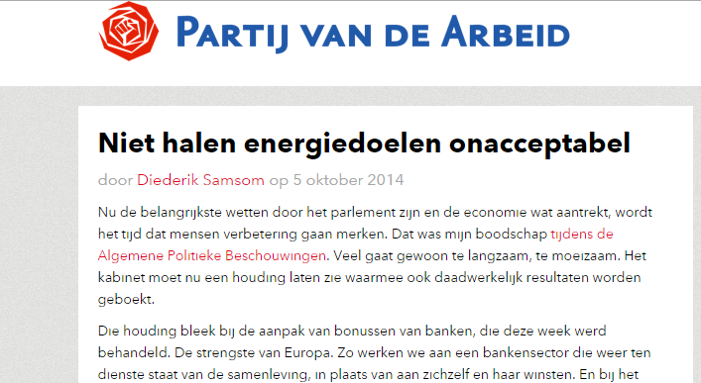
Actualiteit

Slide 4
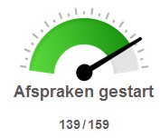
Introductie
Europese afspraken: 14% duurzame energie in 2020 and 16% in 2023
Op dit moment: ~4% duurzame energie
In 2013 is het Nationaal Energieakkoord gesloten
  Ruim 40 organisaties:
      de overheid, werkgevers, vakbewegingen, natuur- en milieuorganisaties, andere maatschappelijke organisaties en financiële instellingen
  139/159 afspraken zijn “gestart”
Toch zijn er zorgen:
  Bezwaren tegen sluiten kolencentrales
  Onenigheid over bijstoken biomassa
  Verzet tegen windmolens

Slide 5
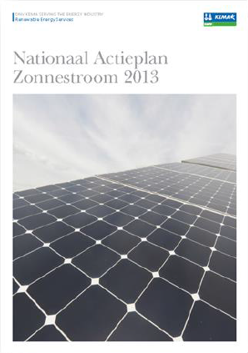
Zonne-energie in het Energie akkoord
Energie akkoord:
  Geen specifieke targets zonne-energie
  Zonne-energie onder categorie decentrale duurzame energie
Toch kan zonne-energie een belangrijke bijdrage
leveren aan het halen van de doelen:
  Nationaal Actieplan Zonnestroom: 4 GWp in 2020
  Wim Sinke: 4-8 GWp
  ECN: 30 GWp in 2030
Huidige stand:
  > 1 GWp

Slide 6
Oude potentieelstudies
Potentieelstudies :
  De Noord (2003): 80 – 100 GWp
  Bersma et al (1997): 90 – 110 GWp
  Koot & Middelkoop (2000): 47 GWp
  Alsema & Van Bummelen (1992): 224 GWp
  KPMG (1999): 27 GWp
Meest recente studie: 2003
Hoeveel netwerkcapaciteit?

Slide 7
Inhoud
Introductie
PV potentieel
PV netwerk integratie
  DNV GL National Smart Grid Model
  Bottom-up aanpak
  Lokale case study
Conclusies

Slide 8
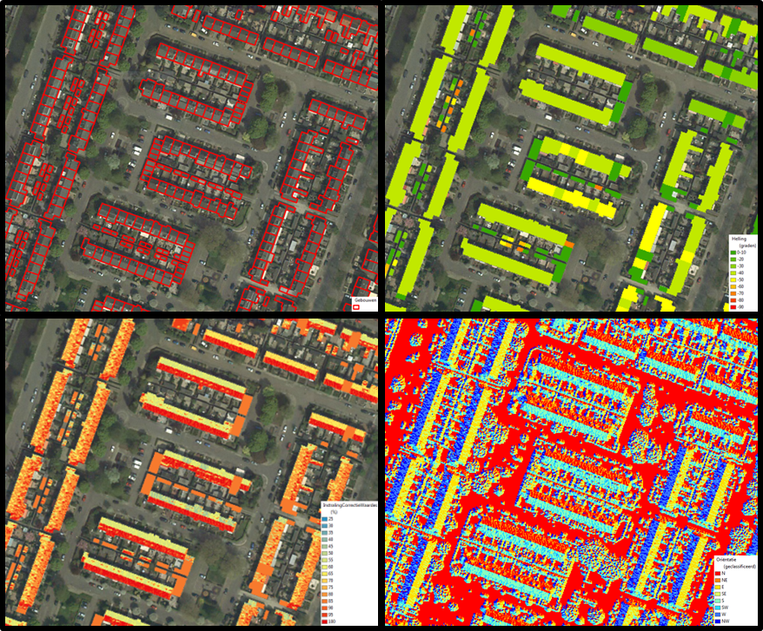
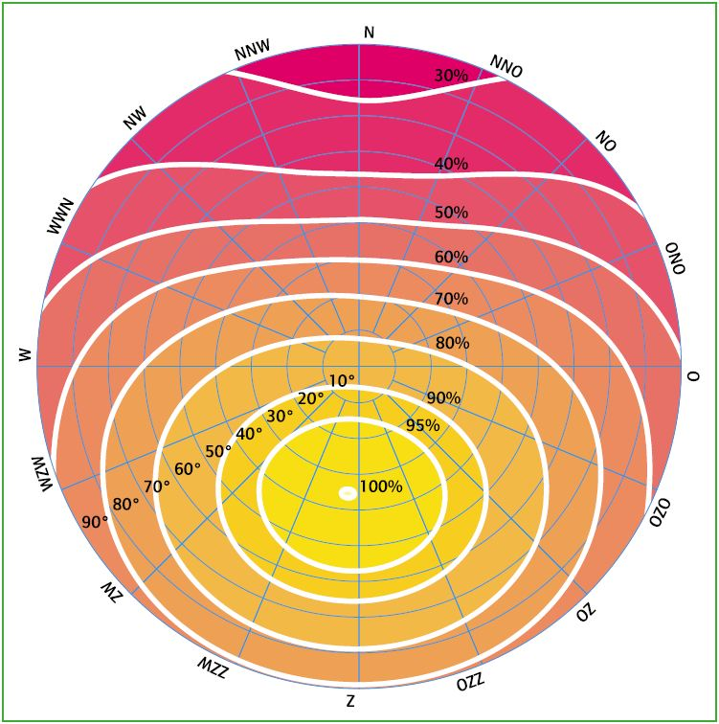
PV Roof Potential
Combining exact building locations with Object Height Register
Calculated tilt and orientation
Corrected average irradiation
Building profiles
Dominant tilt
Orientation
Corrected irradiation

Slide 9
PV Roof Potential
Corrections for roof edges (4%) and obstacles (36%);
No shadow correction
GIS calculations are very time consuming
Determine available m² per building type
  Existing residential & commercial buildings on postal code level
  Figure: Available roof area per building type
Notes:
Vrijstaand = detached house. Tweekapper = semi-detached

Slide 10
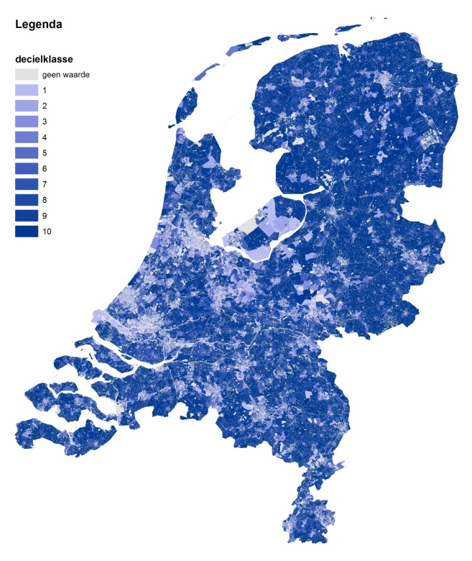
PV Roof Potential
PV technical details | No irradiation correction | Corrected irradiation
Peak power per m² | 160 Wp/m² | 160 Wp/m²
Average peak power production per year | 950 kWh/kWp | 770 kWh/kWp
Average production per m² | 152 kWh/m² | 123 kWh/m²
Roof potential results:
400 km² potential PV surface
Residential | Commercial | Total
41 GWp | 25 GWp | 66 GWp
32 TWh | 19 TWh | 51 TWh
Not included:
PV efficiency increase
Shading by trees and buildings
Infrastructure, ground mounted systems, water, etc.
Notes:
PV efficiency will increase to 30-40% resulting to 130 GWp potential.
Shadows from trees or buildings are not included.
Andere toepassingen ook mogelijk: infrastructuur, vrijeveldopstellingen, water.
Verhoging van rendement naar 17% zou betekenen: 66 GWp wordt 70 GWp
Plaatje: verhouding vraag/productie. Donker is hoge productie per huishouden

Slide 11
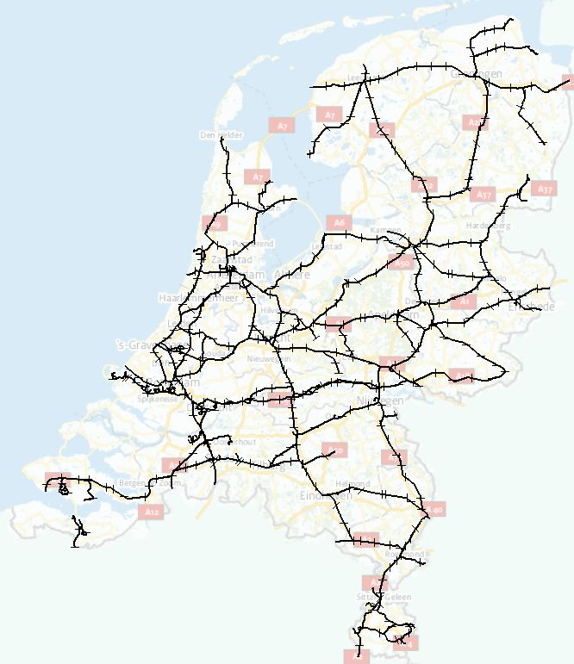
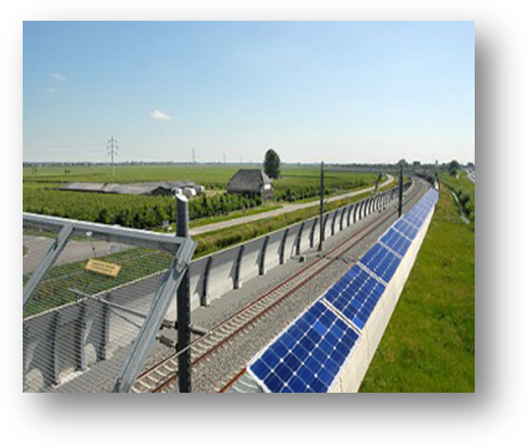
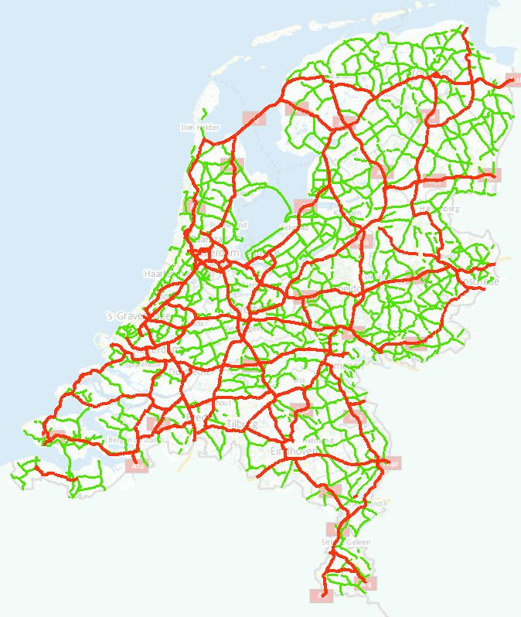
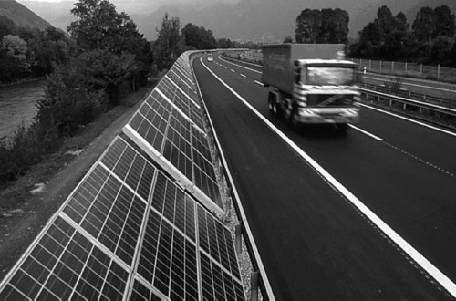
Potential in the non-built environment
Locations | Potential
Railways (solar roof & wall) | 6 GWp
Public roads & high ways (roof / wall) | 18 / 6 GWp
Green Houses | 3 GWp
Waste dump sites | 1 GWp
5% of Lake IJssel | > 10 GWp
10% of grass fields | > 50 GWp
160 Wp/m²
770 kWh/kWp

Slide 12
Inhoud
Introductie
PV potentieel
PV netwerk integratie
  DNV GL National Smart Grid Model
  Bottom-up aanpak
Conclusies

Slide 13
PV Network Integration - Methodology
DNV GL National Smart Grid Profile Model
  4 Scenarios
  700 MWp (January 2014)
  4 GWp (2020)
  20 GWp (2030)
  150 GWp (thought experiment)
Load flow calculations
Not included:
Voltage analysis (case study)
Network stability and flexibility
HV Generation
High Voltage (HV)
HV Consumption
MV Generation
Medium Voltage (MV)
MV Consumption
LV Generation
Low Voltage (LV)
LV
Consumption

Slide 14
Construction of the Smart Grid Profile Model
scenario’s
# dwellings, utility
buildings, penetration
PV, HP, CHP, EV etc.
Time dependent profiles, partly based on actual weather conditions (Dutch VRJ).
Quantification
Simplified grid model based on limited number of user groups.
Simplified merit order model based on limited number of central production units types.
Notes:
VRJ: Verkort Referentie Jaar

Slide 15
Profile approach
Power per production unit
Efficiencies (H & E)
Investments
Fuel cost
Grid loss parameters
Central Production
Volume per user segment
Dimensioning and efficiency of storage
Network
Deterministic profiles
(EV’s, conventional use)
Meteorological impacted profiles (solar-PV, wind turbines, heat pumps)
Profiles based on control schemes
User Groups
Profiles
15
Notes:
VRJ

Slide 16
Shortage/
Surplus
19
grid loss LV:
grid loss MV:
grid loss HV:
9
14
20
Centralized
HV
15
18
16
17
Heavy industry
Central production
Inter-connection
Renewable (wind)
10
11
12
13
Greenhouse cultivation
Commercial
Industry
Renewable
(wind & PV)
MV
glastuinbouw
Utlity
Industry
National
Decentralized
5
6
7
8
Urban dom. existing
Urban dom. new
Rural domestic
Small commercial
LV
1
2
3
4
Urban dom. existing
Urban dom. new
Rural domestic
Small commercial
Local
Notes:
Wat zijn de rode bollen: punten waar Grid losses berkend worden
‘Local’ gedeelte niet meegenomen in deze studie.

Slide 17
Power balance - 700 MWp in 2014
Most sunny hour of the year
Notes:
Bruin: import/export: meerdere interconnecties die beide kunnen doen. Ook binnen het uur.

Slide 18
Yearly energy balance - 700 MWp in 2014
PV electricity share: 0,5%

Slide 19
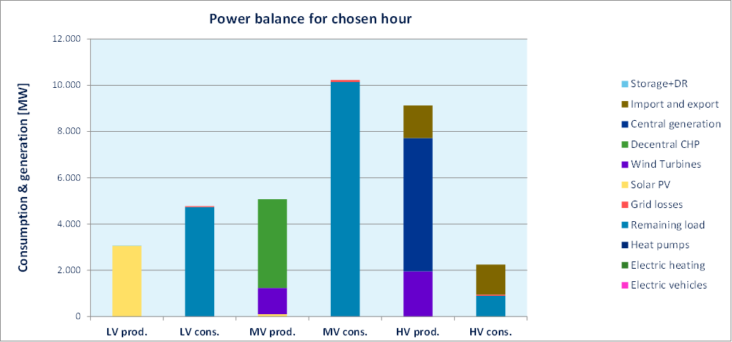
Power balance – 4 GWp in 2020
Most sunny hour of the year
Notes:
Geen probleem bij 4 GWp
Piek rond 3 GWp ivm orientatie, temperatuur en hoek.

Slide 20
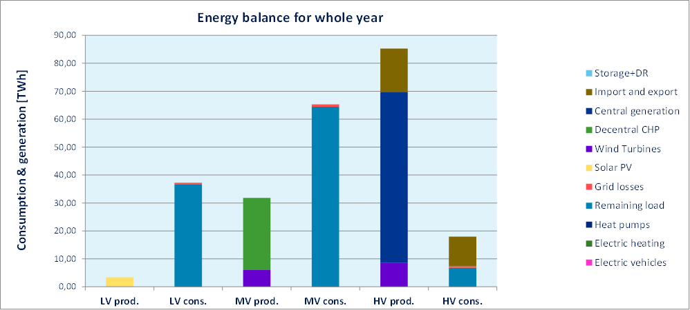
Yearly energy balance – 4 GWp in 2020
PV electricity share: 3%

Slide 21
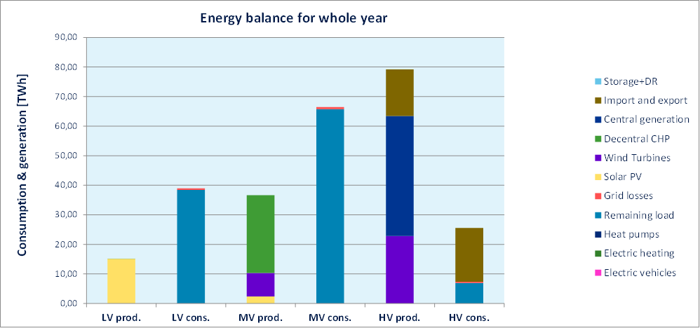
Yearly energy balance – 20 GWp in 2030
PV electricity share: 13%
Notes:
PV wordt significant in energiebijdrage

Slide 22
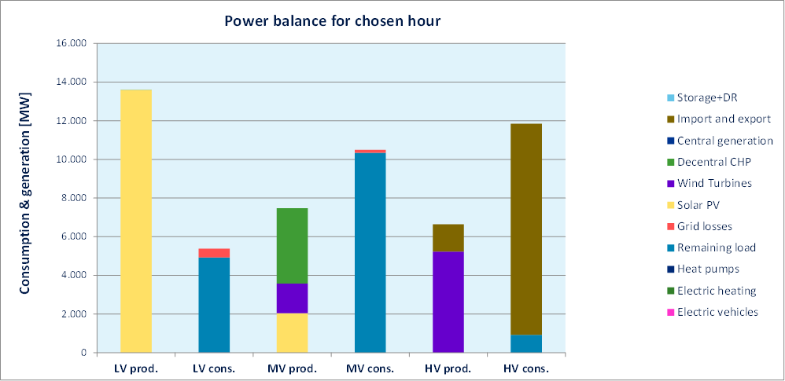
Power balance – 20 GWp in 2030
Most sunny hour of the year
Large export (brown bar, HV cons.)
Notes:
Veel export.
Verschil LV prod en LV cons is bijna evengroot/groter dan vraag in winter. Is dit het kantelpunt? Modelheeft altijd een oplossing…

Slide 23
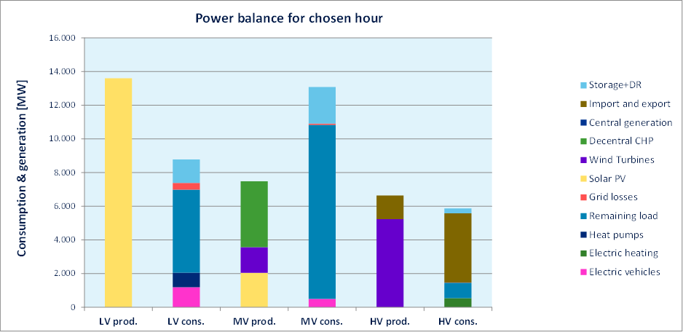
Power balance – 20 GWp in 2030
Demand response (20%), electric vehicles (50%) & heat pumps (45%)
Less export
Curtailment and storage could bridge the gap between LV production and consumption
Notes:
Minder export.
Kleiner gat met LV cons/prod

Slide 24
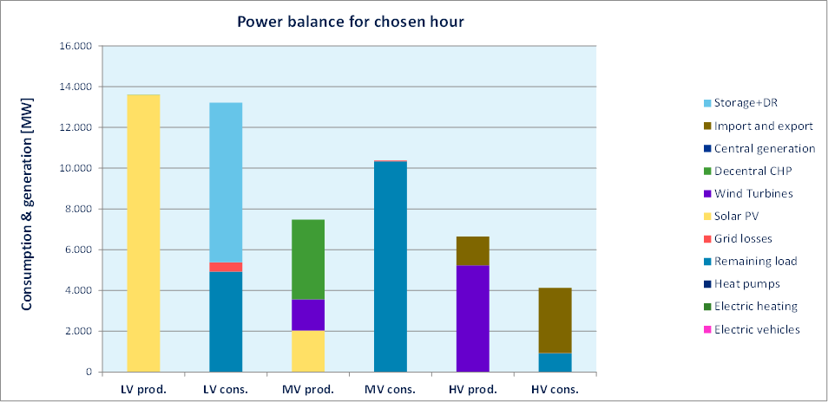
The role of storage
Add 2 kWh energy storage for each 5 kWp
This model gives snap shots, energy losses and possibly costs, but not a tripping point
Notes:
Low Voltage network is the limiting factor

Slide 25
Inhoud
Introductie
PV potentieel
PV netwerk integratie
  DNV GL National Smart Grid Model
  Bottom-up aanpak
Conclusies

Slide 26
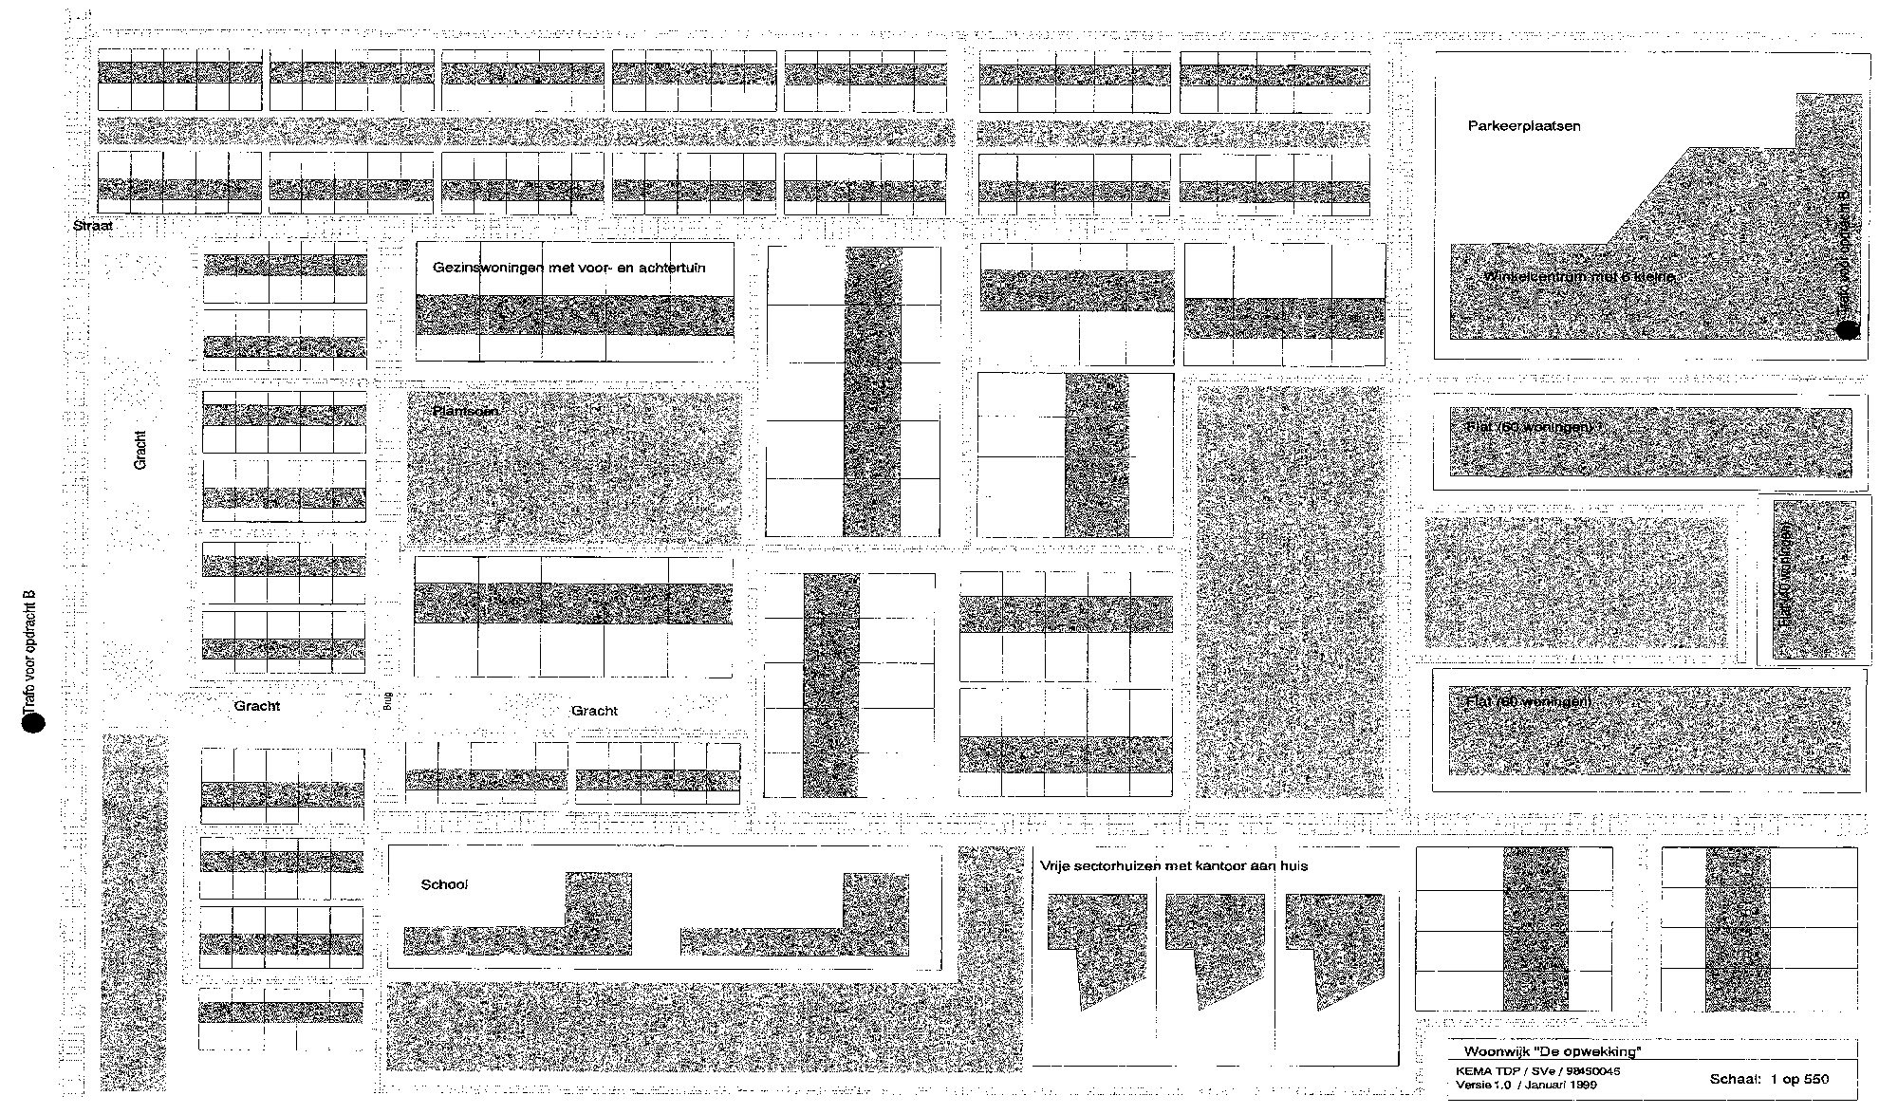
What can the network handle? A bottom-up approach
The ‘Meeks grid’ represents a typical Dutch residential community.
Our simulations calculate the impact of a scenario on variations of this community
25 x B
10 x B
25 x C
10 x C
5 x A
Commercial
5 x B
12 x C
30 x A
MV/LV
630 kVA
District heating
40x G
5 x A
10 x E
5 x E
10 x E
60x H
20 x E
Commercial
F
F
F
A-D = town house, E-F = detached, G-H = flats, 2 commercials (school, shopping)
Notes:
Check de 630 kVA ~ 630 KW transformer

Slide 27
Approach – “Meeks grid” electric network layout
Simplified layout of the “Meeks grid” electric network
Only two types of grid components considered: transformer (incl. busbars and switches) and cables
Switches
Transformer station
to Block A
to Block B
MV/LV Transformer
to Block C
to Block D
MV grid connection
to Block E
Cables going into the neighbourhood
to Block F
MV busbar 10 kV
to Flat G
to Flat H
to Commercial 1
to Commercial 2
LV busbar 400 V
to District heating

Slide 28
Results from bottom-up approach
Peak production levelled with peak consumption: 11 GW
Coincidence factor of PV & over dimensioning of transformers: 16 GW
30% curtailment (2-3% energy loss): 23 GW
Temporary transformer overload (few hours/year, 120%): 27 GW
Demand response (0,5 kW per household): +4 GW
‘Conventional’ grid reinforcements: 50 GW
Electricity storage (5 kW per household): +40 GW
Assume homogeneous distribution of PV
Without seasonal energy storage the demand in winter must be provided by other sources
Grid voltage issues will arise (see case study)
Notes:
NB: these values reflect real GW, not GWp. In fact GWp could be higher, but this is not calculated. These number are a minimum for GWp

Slide 29
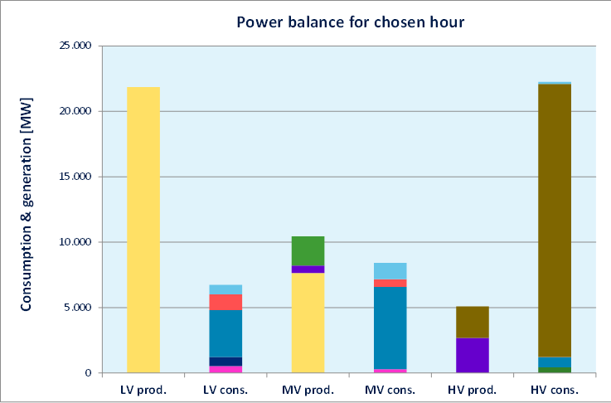
150 GWp thought experiment
This scenario will only be plausible if all possible measures are taken:
  E.g. 75% curtailment (35-40% energy loss)
  Grid extensions
  Seasonal storage (hydrogen, thermal acquifiers, power-to-gas, etc)
75% curtailment; 20% DR; 50% HP, EV
75% curtailment; 20% DR; 50% HP, EV, Storage

Slide 30
Inhoud
Over DNV GL
Introductie
PV potentieel
PV netwerk integratie
  DNV GL National Smart Grid Model
  Bottom-up aanpak
  Lokale case study
Conclusies

Slide 31
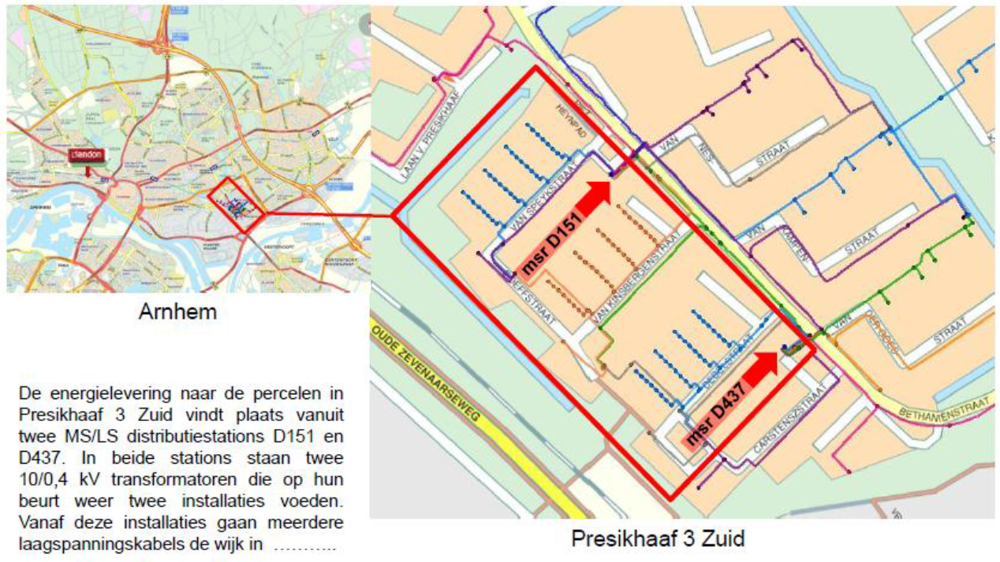
A local case study – a neighbourhood in Arnhem (NL)
Source: Liander, Danny de Pater, 2014

Slide 32
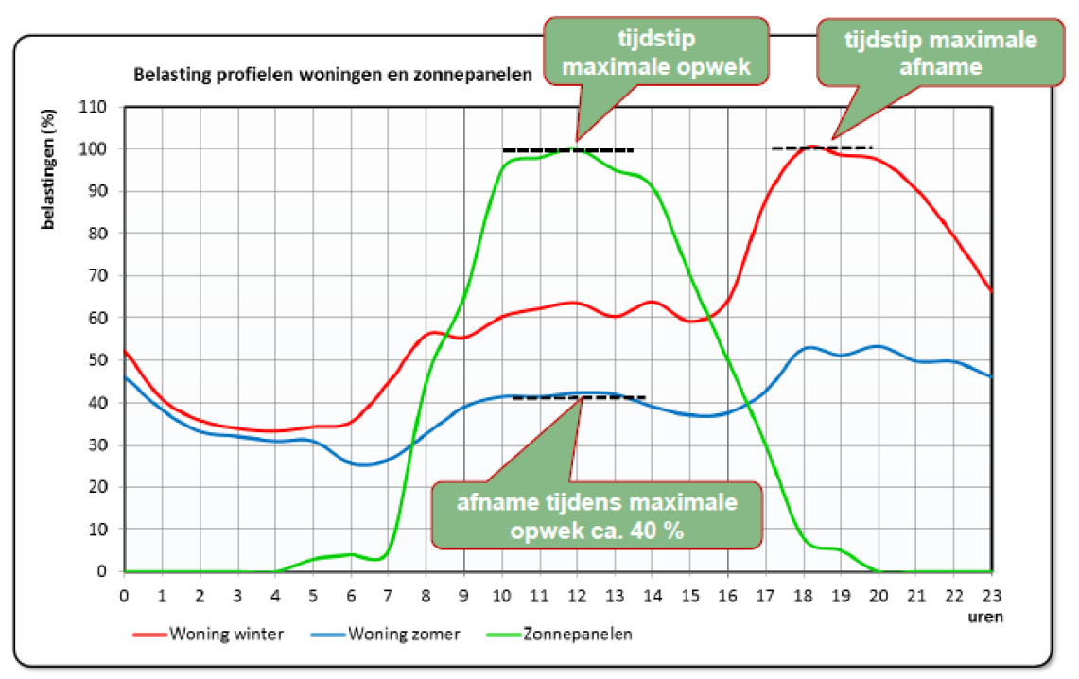
Coincidence issues production and demand
Source: Liander, Danny de Pater, 2014

Slide 33
Lessons learned from case study
At maximum PV production the local grid voltage will rise
At maximum load the local grid voltage will drop
The difference between elevated voltage and lowered voltage is limiting the amount of PV and heat pumps.
Exceeding the voltage limits would mean network extension (larger cables and connections)
This induces high social economic costs for a small area: €3000-5000 per household.
Grid operators claim that 1,5 kWp per household is the limit without grid extension (i.e. 33% of electricity demand)
Source: Liander, Danny de Pater, 2014
Notes:
1,5 kWp per household, with 8 million households ~ 12 GWp

Slide 34
Inhoud
Introductie
PV potentieel
PV netwerk integratie
  DNV GL National Smart Grid Model
  Bottom-up aanpak
Conclusies

Slide 35
Conclusions
Abundance of roof area
66 GWp with current technology
>150 GWp full potential with all applications
16 GW in present network without measures
(Smart) Grid measures can allow up to 100 GW in the LV grid
Boundary conditions & Limitations
Homogeneous distribution of PV
(Local) voltage issues will appear earlier
Spinning reserve must be provided
Seasonal energy storage is necessary

Slide 36
Thank you for your attention!
Bas Vet
Bas.Vet@dnvgl.com
+31 (0)26 356 2836

