Slide 1
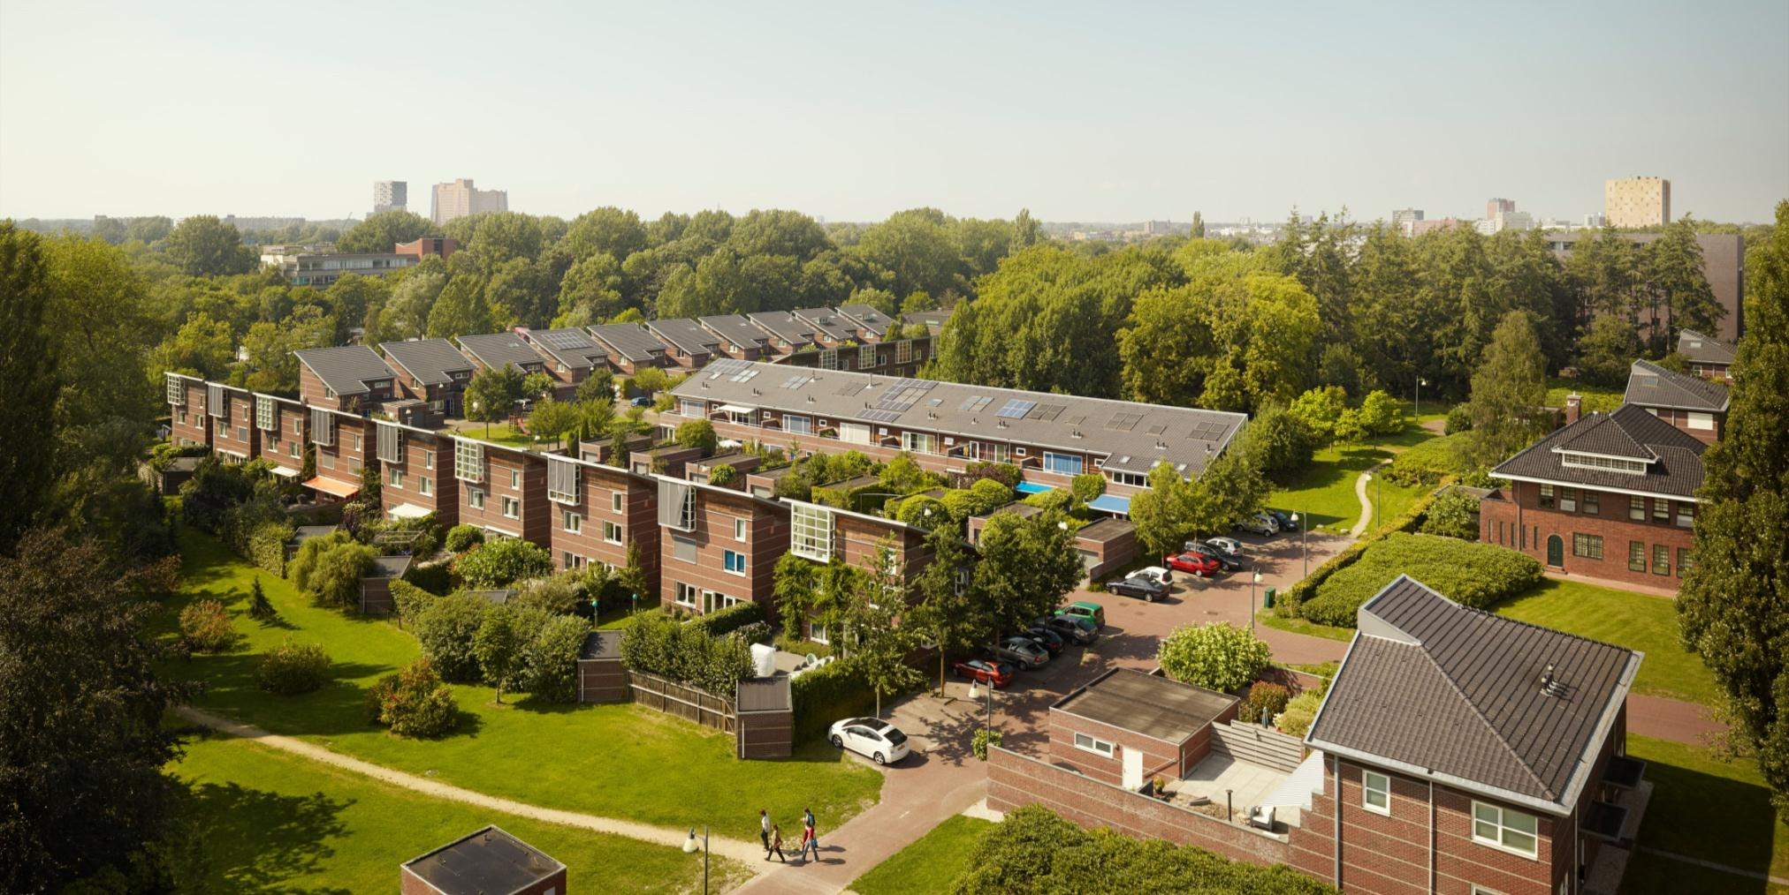
PowerMatching City
Groningen, The Netherlands
Notes:
Doel en opbouw toelichten

Slide 2
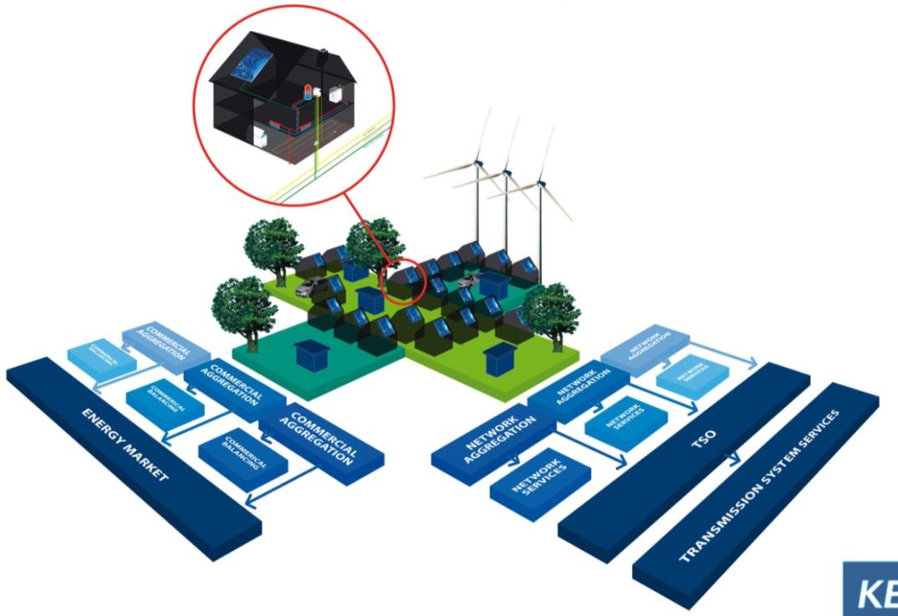
Balancing all stakeholders’ needs
1. EnergyManagement@Home
(In home optimization)
1. EnergyManagement@Home
(In home optimization)
4. Power4Climate
(Valorisation and Imbalance Reduction)
4. Power4Climate
(Valorisation and Imbalance Reduction)
2. Grid@Work
(reduce peak loads)
3. Energy4sale
(Virtual Power Plant)
2. Grid@Work
(reduce peak loads)
3. Energy4sale
(Virtual Power Plant)
Notes:
Weging toevoegen – met balans
Indien haalbaar grafieken met meetresultaten
Schaalbaarheid
Kosten transparantie

Slide 3
How can a smarter grid be realised in practise?
Goal of PowerMatching City 2 is to investigate the added value of smart for:
Network operator: capacity management
End user: engagement and empowerment
Energy supplier: new energy services & processes
By:
Real-time balancing of supply and demand
New energy services & market models
Local sustainable energy production
Validating cost benefit models
PowerMatching City demonstrates a smart solution to the energy transition’s challenges.

Slide 4
A total smart energy solution
Notes:
Vervangen door nieuw beeldmateriaal – combi met Centraal – Lokaal beeld.

Slide 5
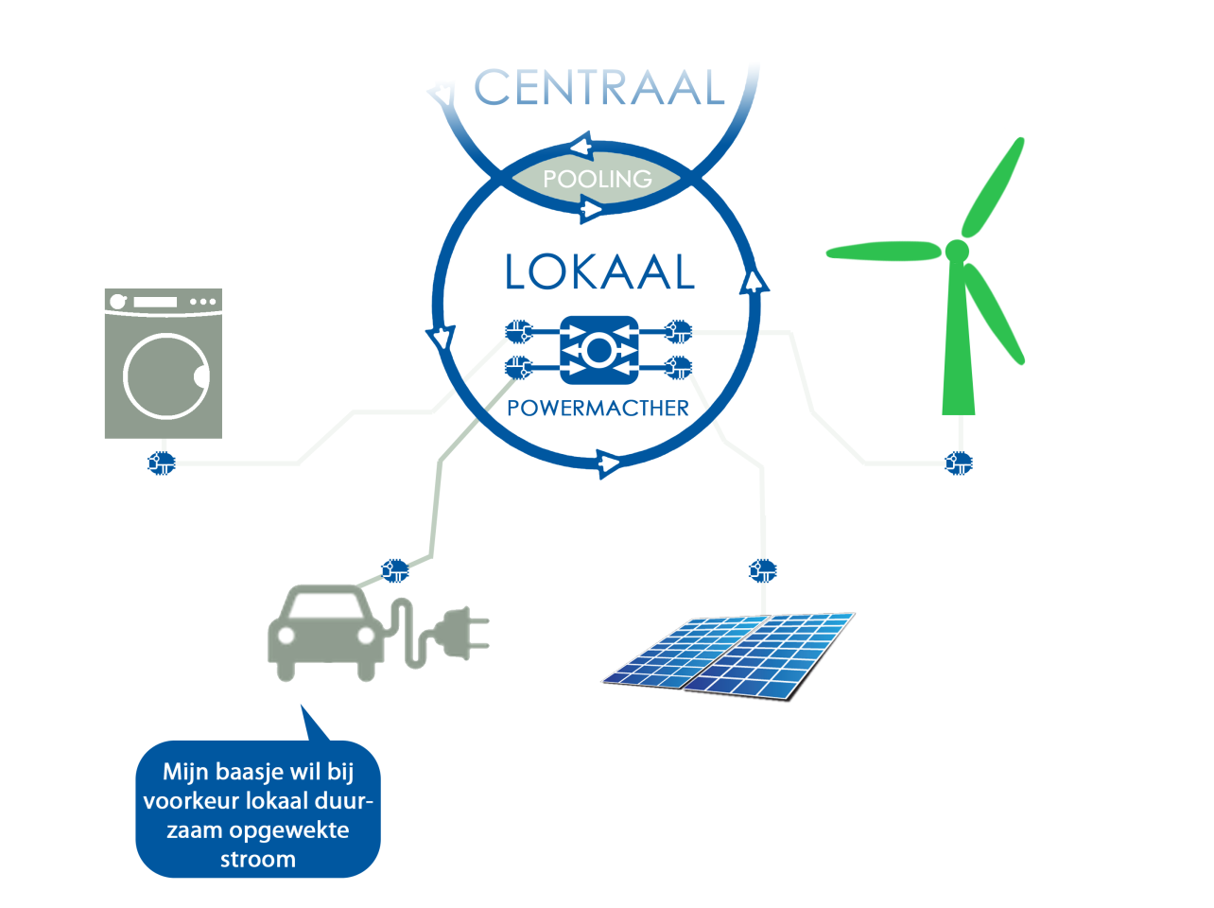
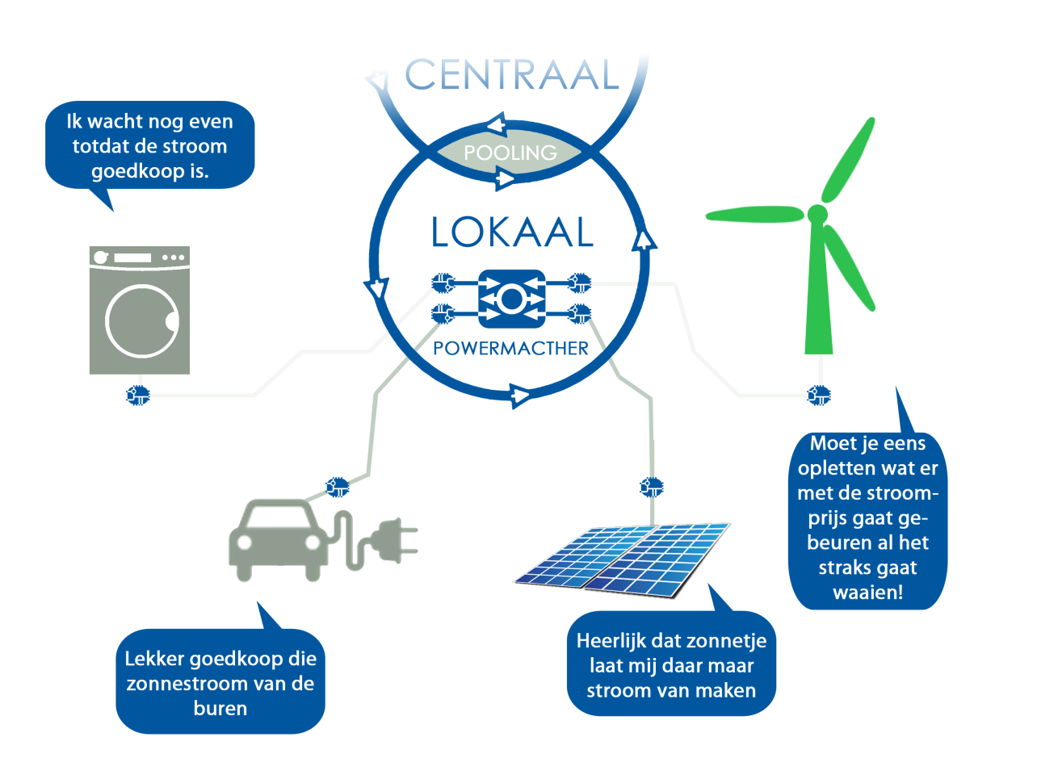
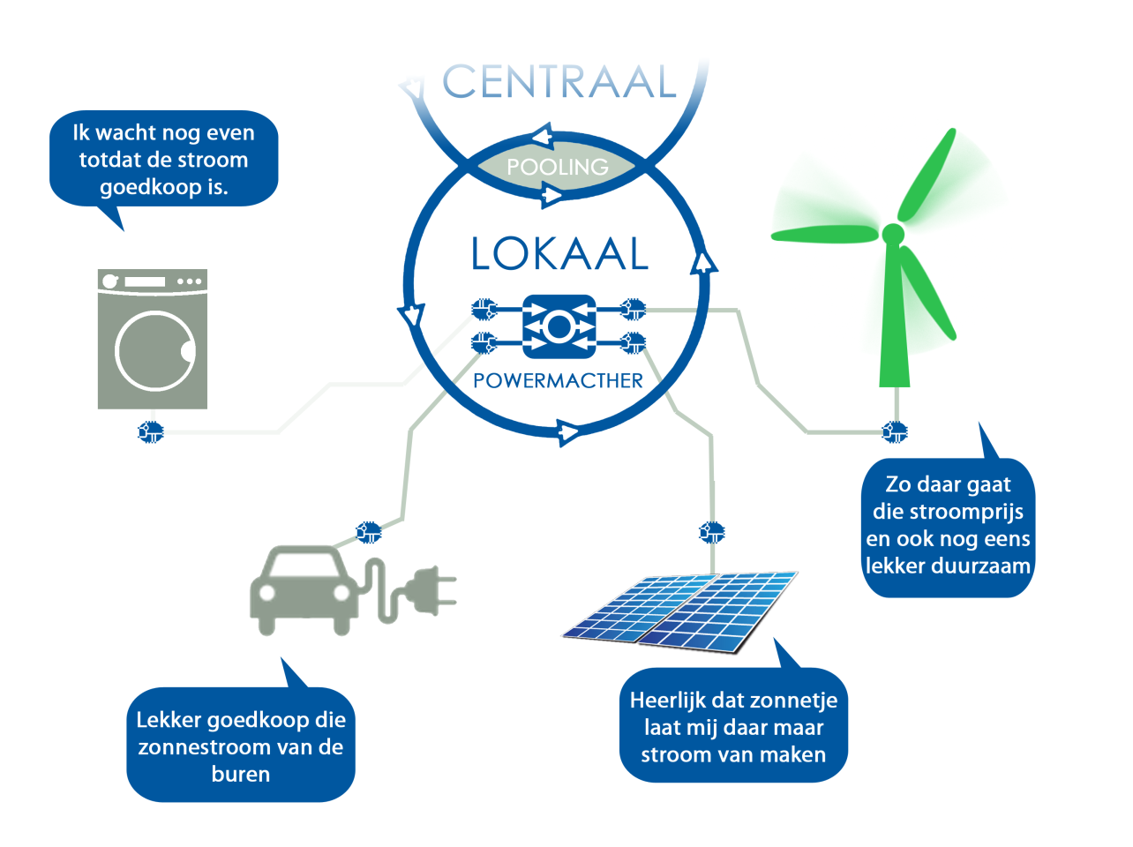
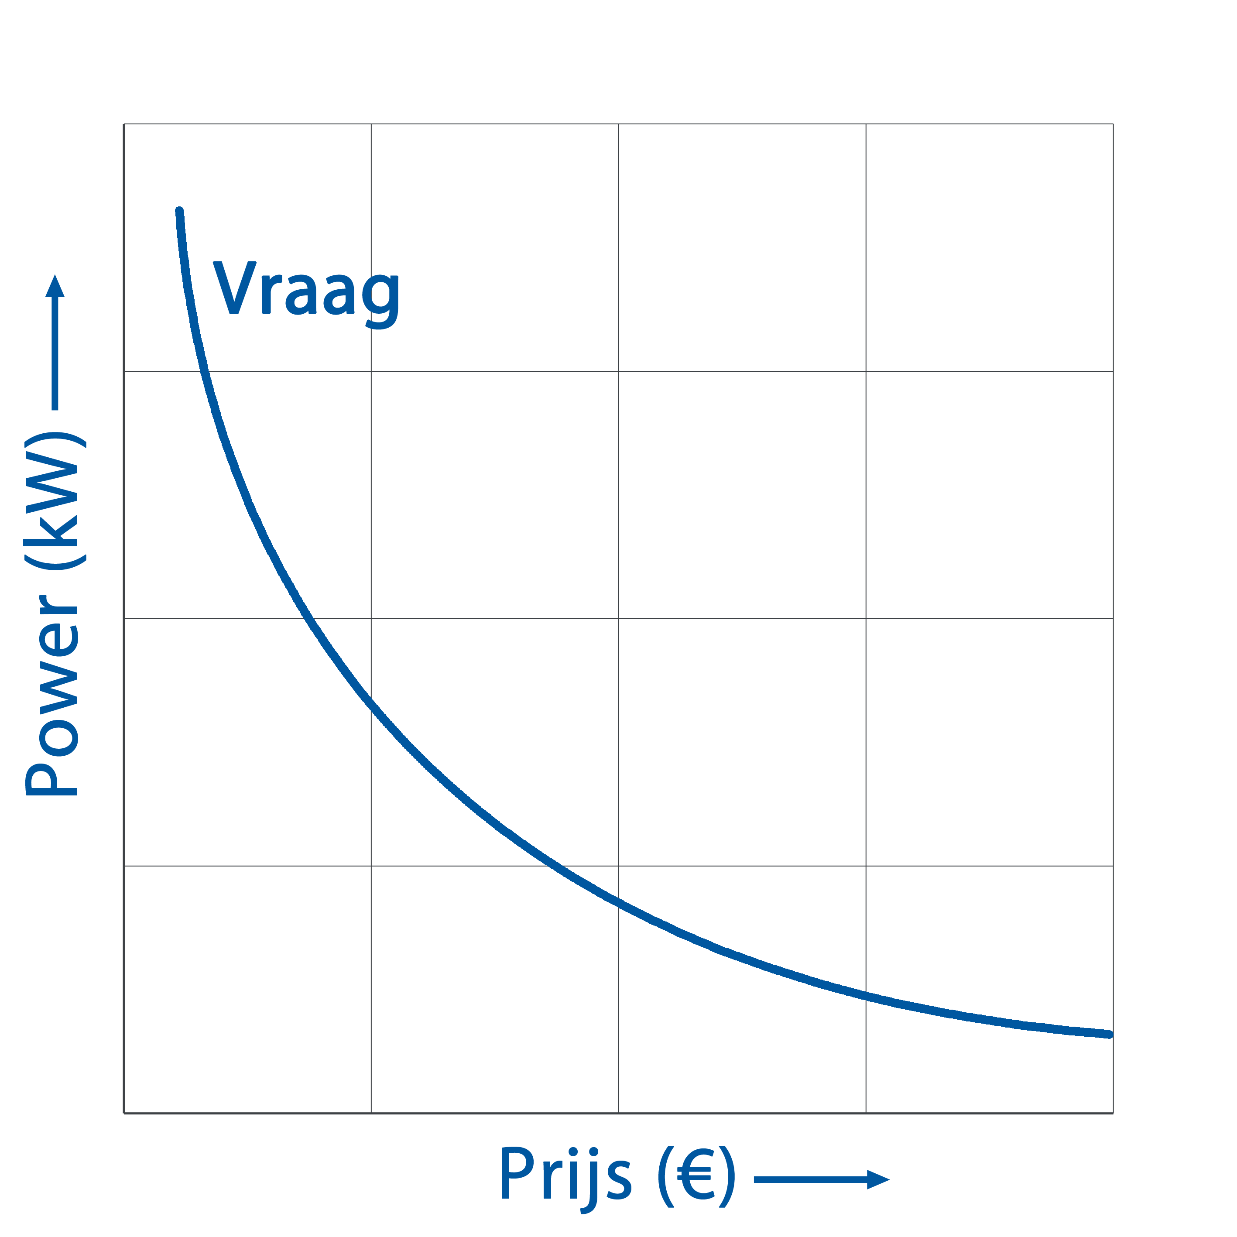
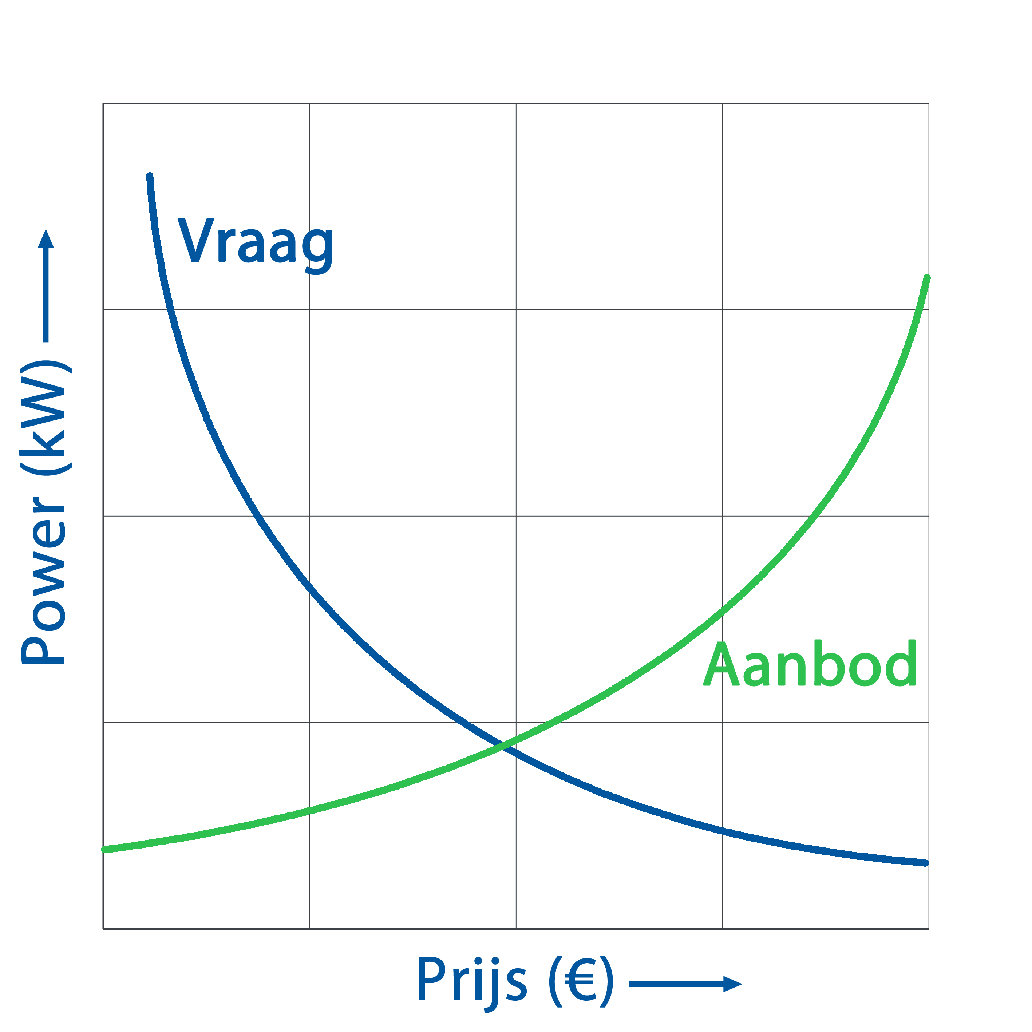
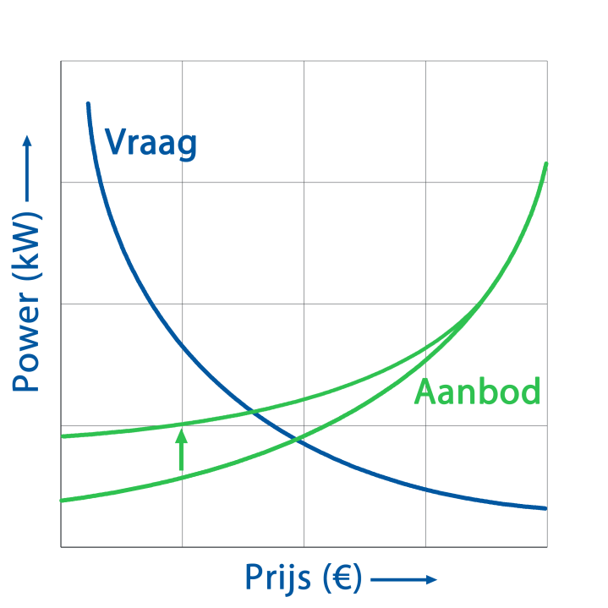
What does the PowerMatcher do?

Slide 6
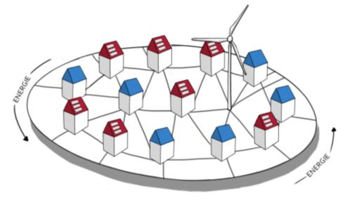
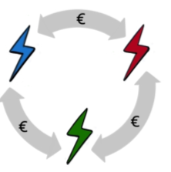
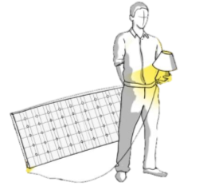
New Energy services
Together pleasantly sustainable
Smart cost savings
Maximum use of generated energy in the community
Drivers: sustainable, independent, and comfort
Always benefit from the lowest price offering
Drivers: costs, and comfort
Notes:
Second phase of PMC is to demonstrate new end user propositions. These are based on actual data enabling real time pricing and insights in your own energy consumption as well as energy production and a minute-by-minute basis.
Phase 2:
Implement the PowerMatcher solution in the wholesale and billing processes
Validate the peak load reduction potential of the grid by extending the field trial with households behind a single transformer
Expand the smart electric vehicle charging experiment
Validate the cost-benefit model with data from the field trial
From commodity to services
Consumers can choose: source of energy, provider, moment of delivery, …

Slide 7
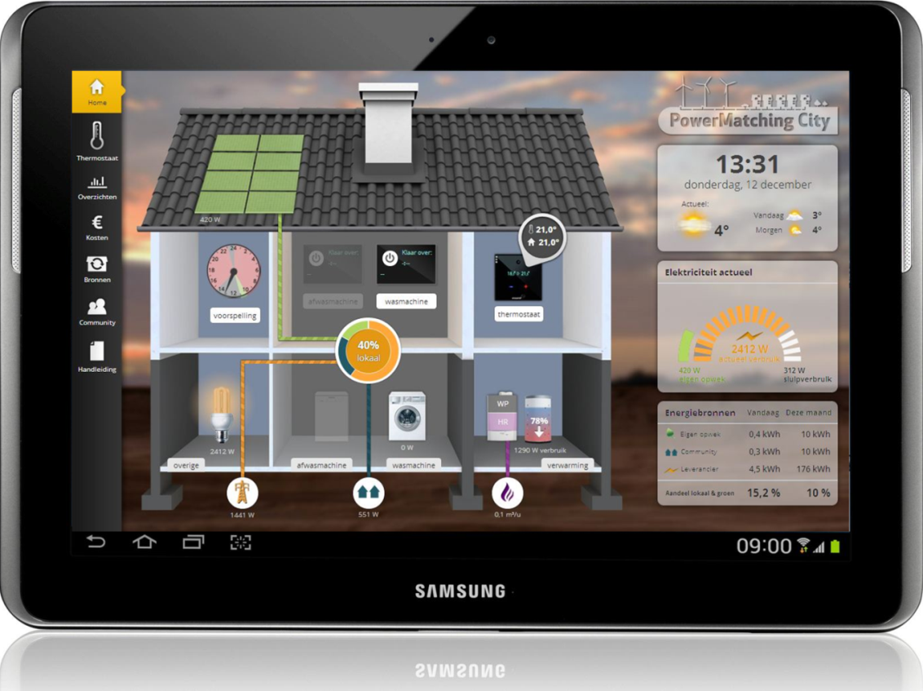
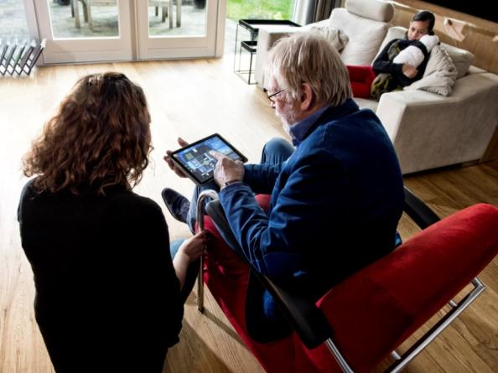
Supported with an energy monitor

Slide 8
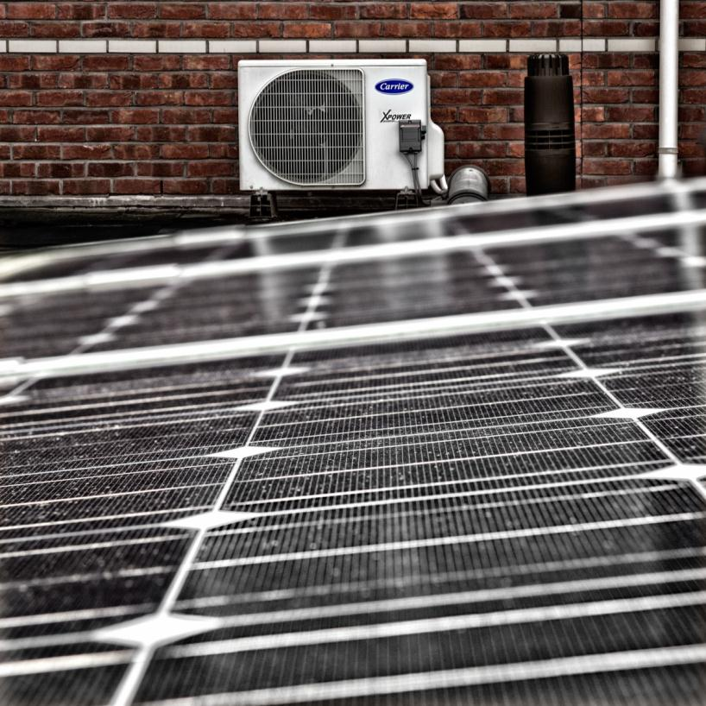
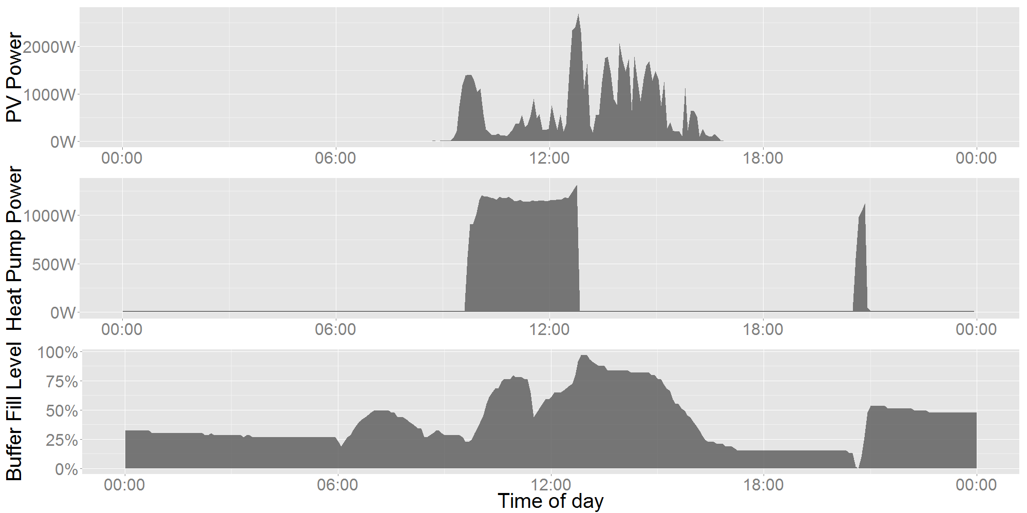
Combination of PV with hybrid heatpumps

Slide 9
Thank you for your attention
Albert van den Noort
Albert.vandenNoort@dnvgl.com

