Slide 1
Inpassing PV
Arnhem, November 19, 2014
Prof. Wil Kling
w.l.kling@tue.nl

Slide 2

Outline
Problem statement
Balancing
Network issues
Conclusions

Slide 3
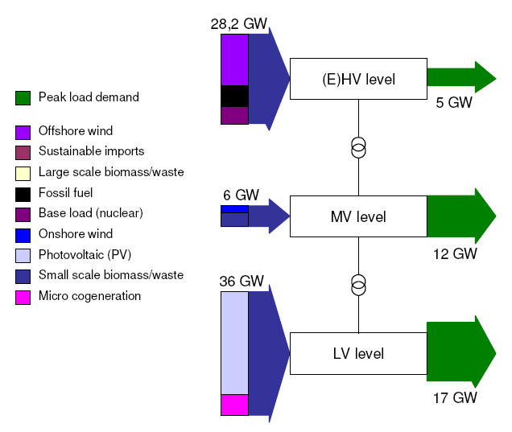
Decentral Supply Scenario
(Energy report 2008, Meeuwsen TU/e)

Slide 4
Power system issues (1)
Design and planning
Processing operational information
Controlling flows and maintain stability
(real-time control)
Balancing supply-demand at all times (reliable operation)

Slide 5
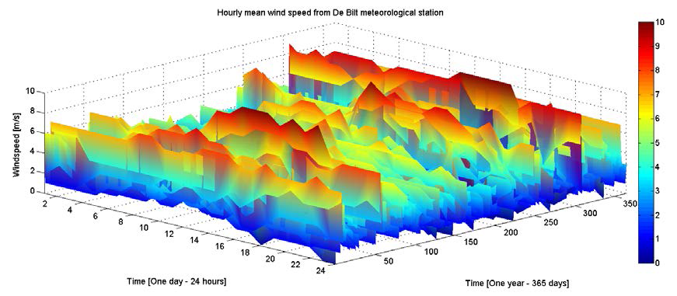
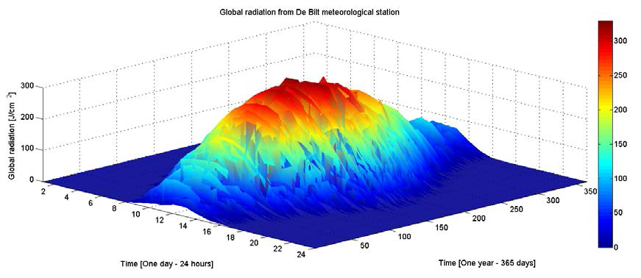
Power system issues (2)
Wind variation!
Sunshine variation!

Slide 6
Power system issues (3)
Market prices and market participation!
What is the value of flexibility?

Slide 7
  Key questions for research
  Can supply and demand be matched in real-time?
  Can renewables be efficiently integrated in the power system?
  Is quality of service (voltage and power) guaranteed?
  Do markets for energy and ancillary services perform well?
  How to engage the customer in the process?
  Is there sufficient electrical network capacity?

Slide 8
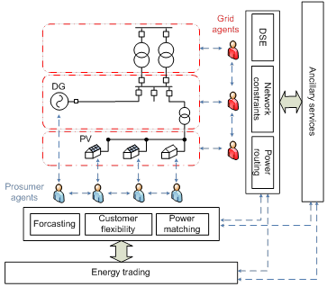
The use of agents for power routing and power matching

Slide 9
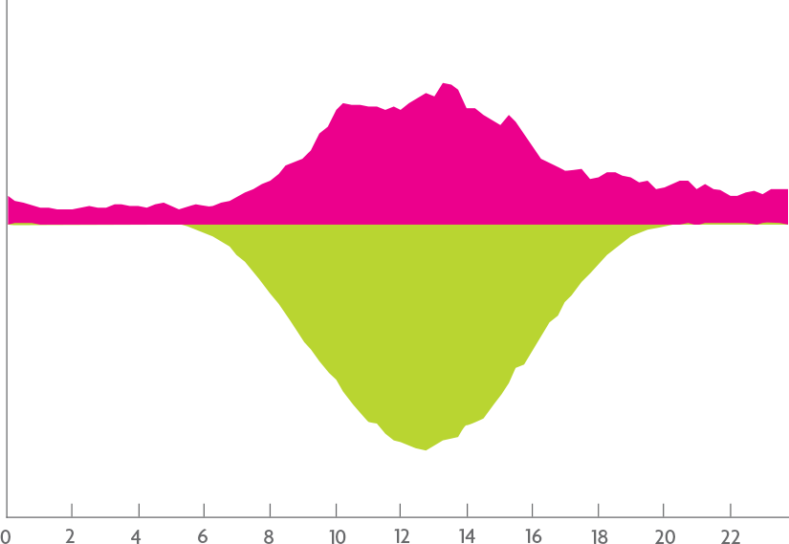
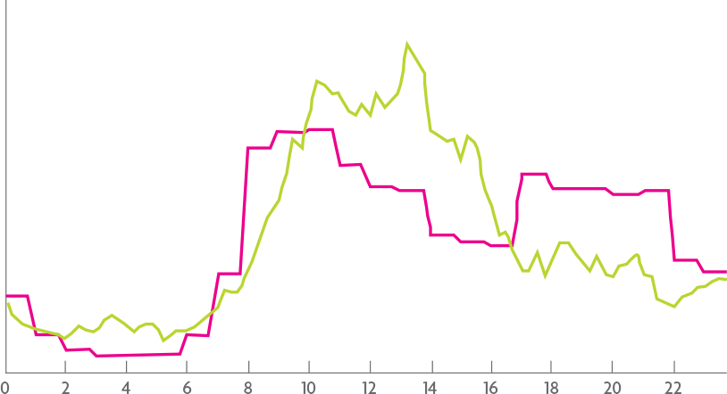






Pilot “Your Energy Moment” – First results
Your Energy Moment: Jan. 2013 till Aug. 2013
Average Washing Machine Consumption (week-days)
WM Consumption
EU household
PV Production
YEM household
Production & Consumption
Consumption
Result: 50% of the cycles are ‘smart’: the WM is turned on
when electricity is locally generated via PV panels.

Slide 10
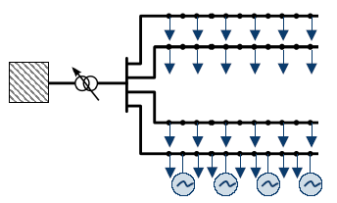
Voltage profiles along feeders with and without PV

Slide 11
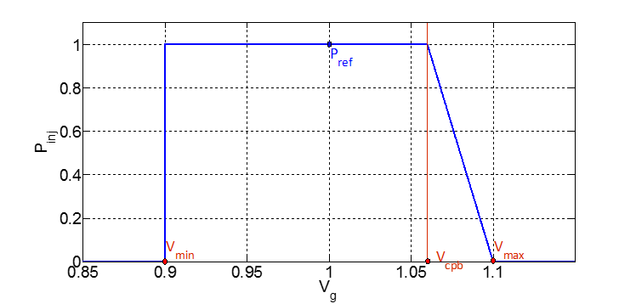
Local Inverter control to prevent overvoltages

Slide 12
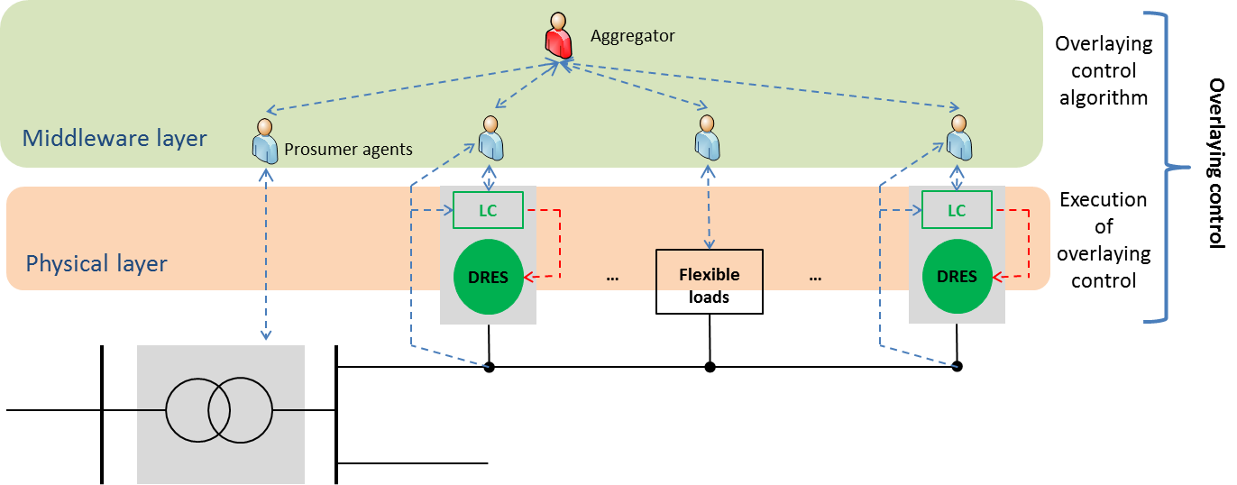
Multi-objective Optimisation in EU project

Slide 13
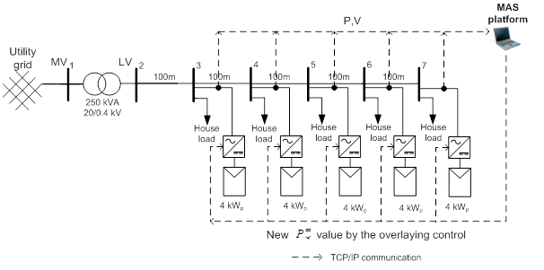
Overlay control for fair power curtailment

Slide 14
Conclusions
PV has to be matched with demand
Local balancing may help
PV gives overvoltages in distribution networks
Mitigation measures must include demand response otherwise curtailment is inevitable
Smart Grid functionalities are essential

Slide 15
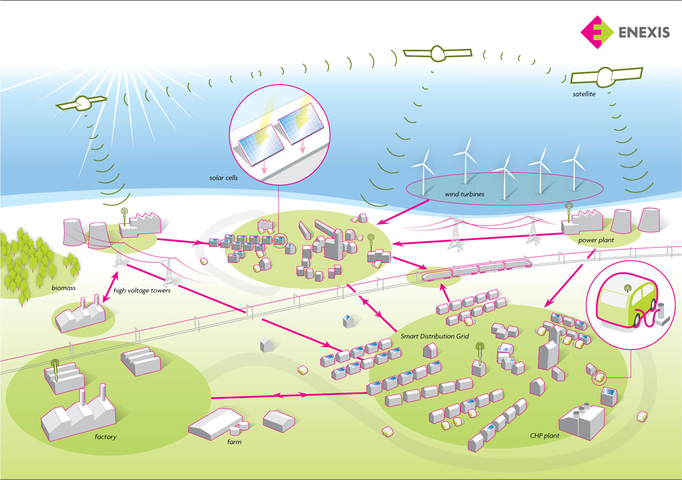
Thank you for your attention!

